Slide 1
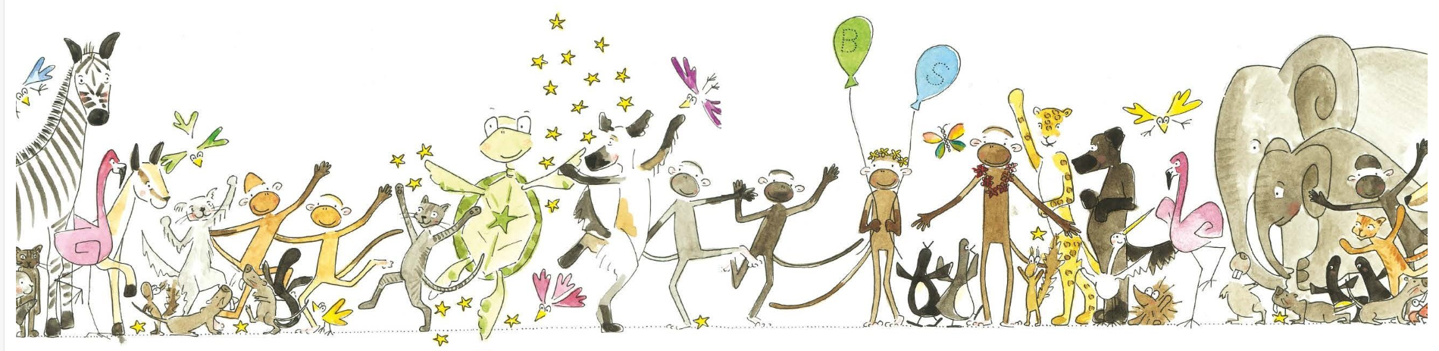
HANDWRITING
Kinetic Letters®
Notes:
Handwriting is an area that we are developing at Woodside. Have purchased this programme – spoke with the creator and other schools that are using it. It’s highly recommended.

Slide 2
The programme has four main threads:
• Making bodies stronger,
• Holding the pencil,
• Learning the letters, and
• Flow and fluency.
The programme enables children to develop legible handwriting that is produced quickly and automatically. With the development of automaticity, handwriting becomes a valuable tool and not a hindrance to learning.
Notes:
You will see - formation of letters is only a small part of legible and automatic handwriting.

Slide 3
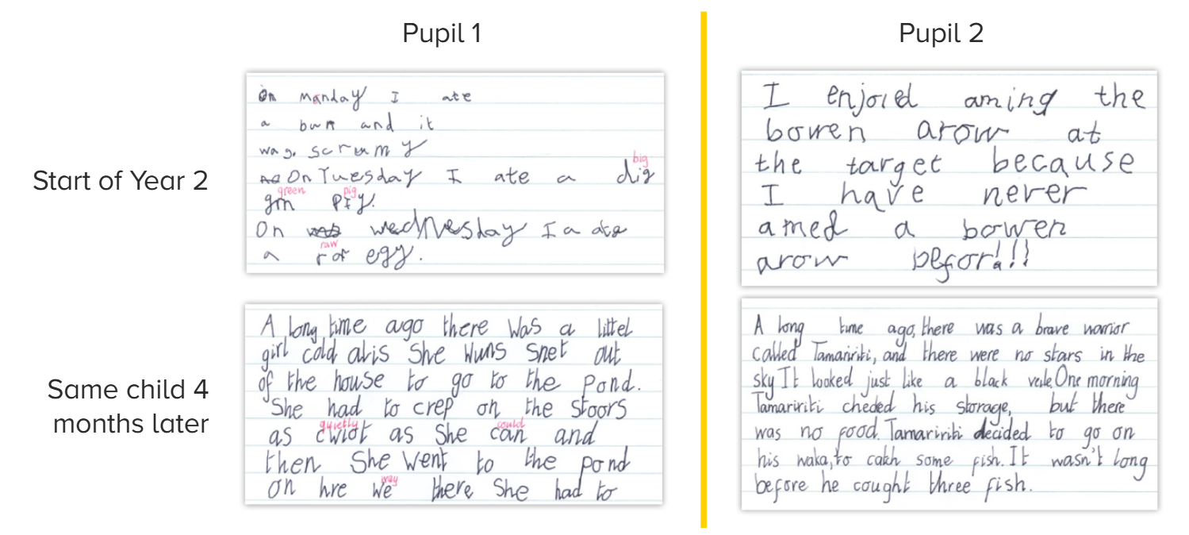
Progress made from using the programme:
Notes:
Taking away the cognitive load to form letters allows for more time to be spent on constructing sentences and developing ideas.

Slide 4
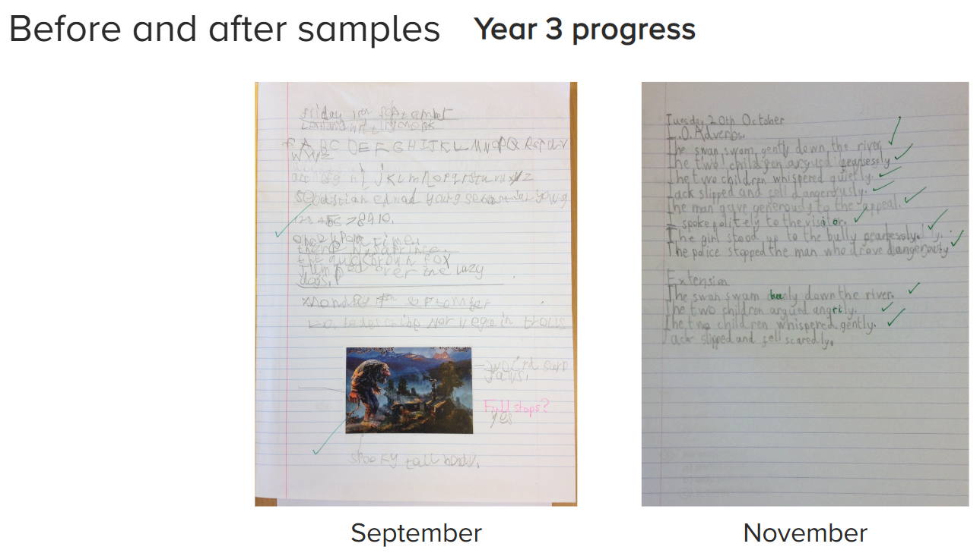

Slide 5
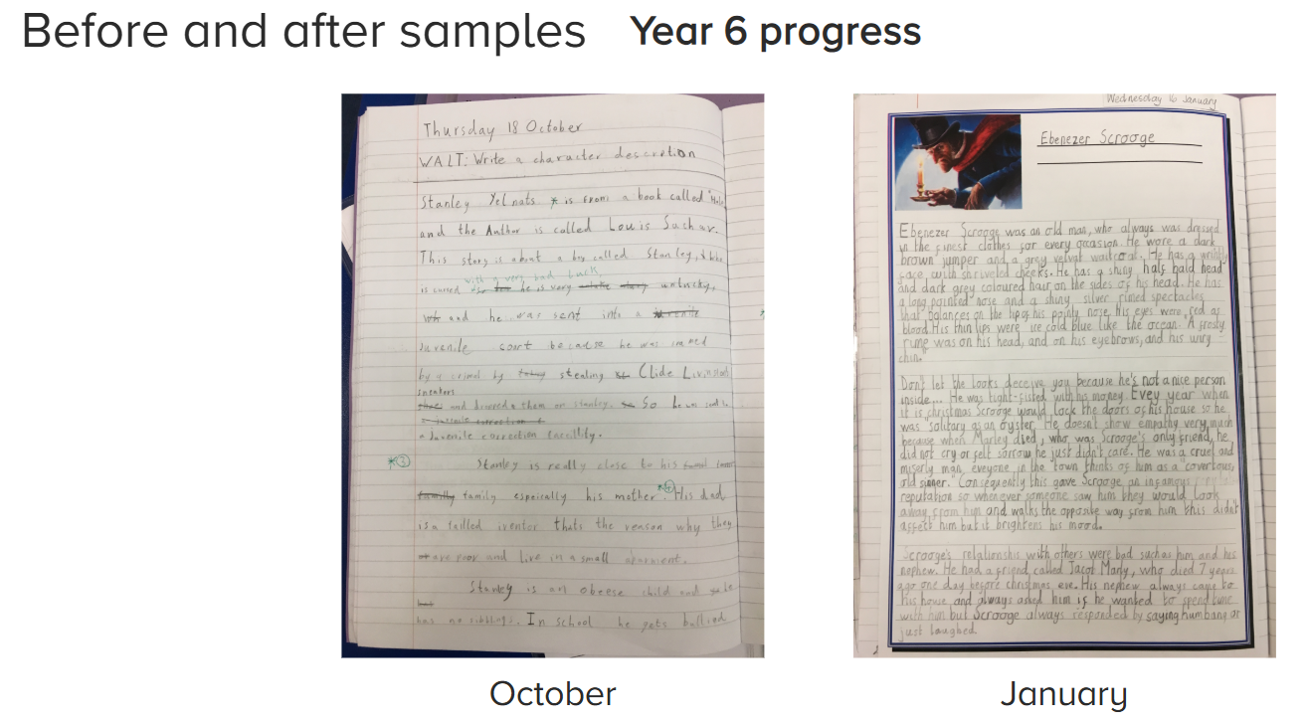

Slide 6
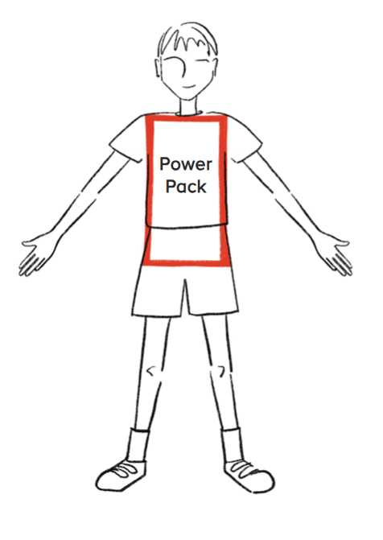
1. Making bodies stronger
You have to be strong to write!
Notes:
Pelvic girdle (near bottom) – enables chn to sit still and concentrate without wriggling, and the postural support needed for fast, legible handwriting
Shoulder girdle (near top) – stabilises the body and supports the arm and wrist so pupils can sit correctly at a table and use their writing hand and helping hand appropriately.

Slide 7
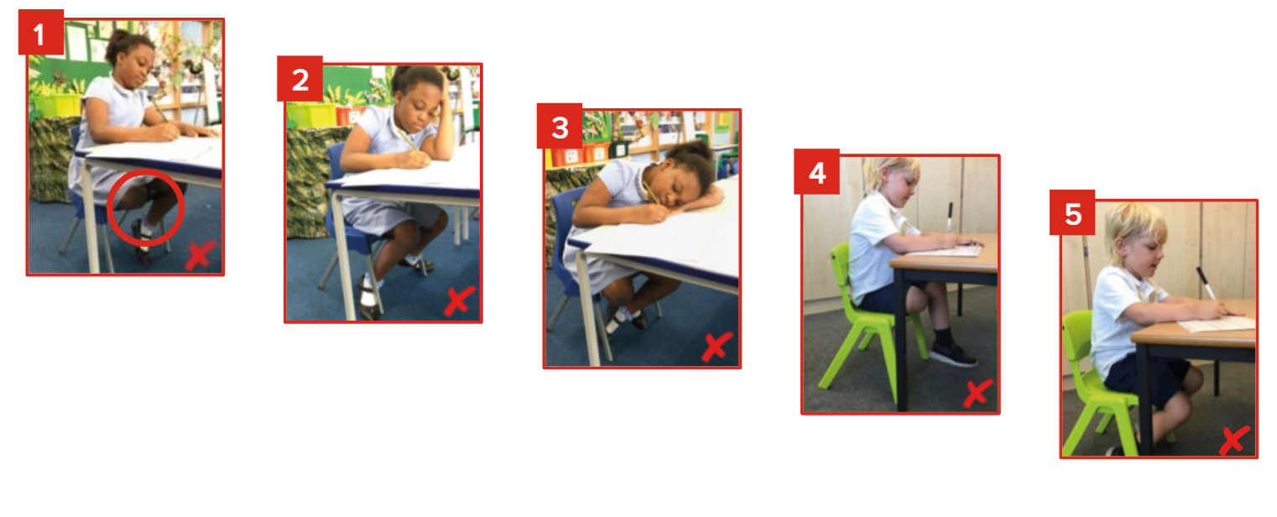
flopping over the table
using a hand to prop up the head
tucking one leg up under the other,
wrapping legs around the chair legs
crossing ankles
Children sit like this when writing if their power packs aren’t strong enough.
Notes:
Children show writing positions that are not good
Creates issues – children can’t see their work, they get a dead leg and so are wriggly, they rock on their chairs

Slide 8
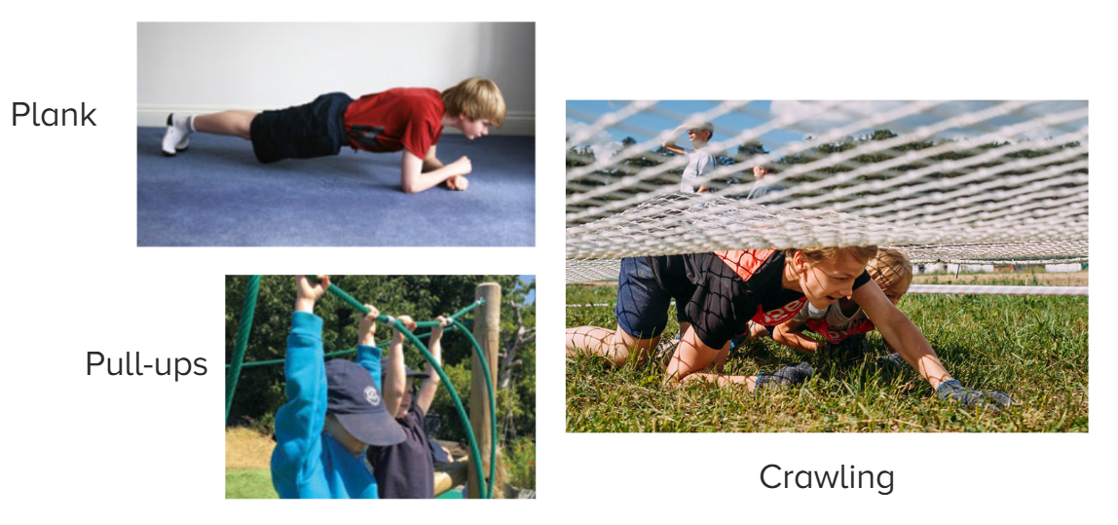
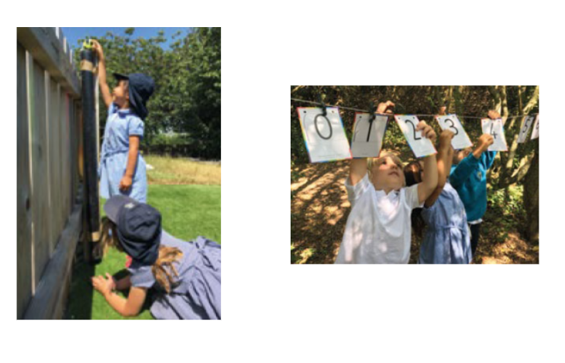

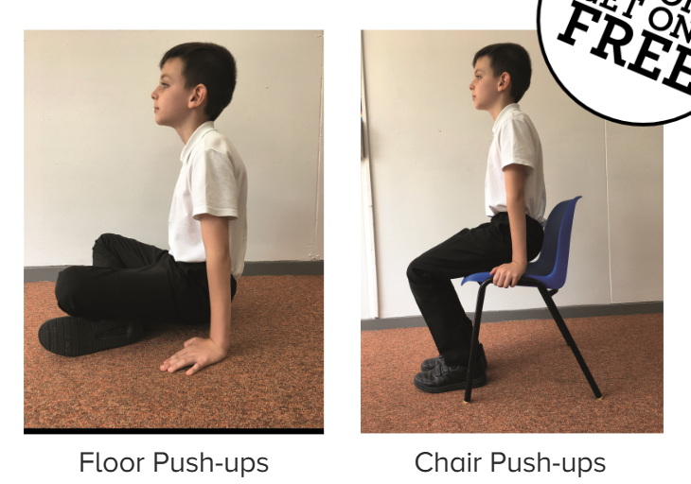
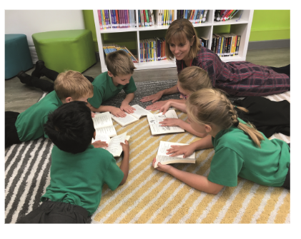
How are we working to strengthen our power packs?
Notes:
Thinking about how we can move more activities to the floor and develop ‘power pack’ strength.

Slide 9
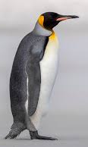
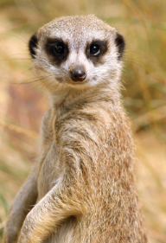
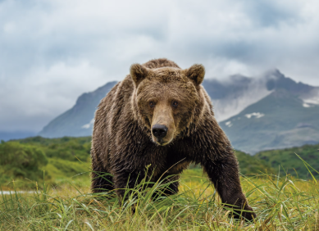
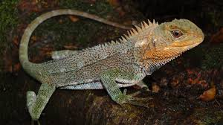
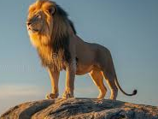
Animal Positions
Notes:
Children to model – these are also ways we are developing power pack strength.

Slide 10
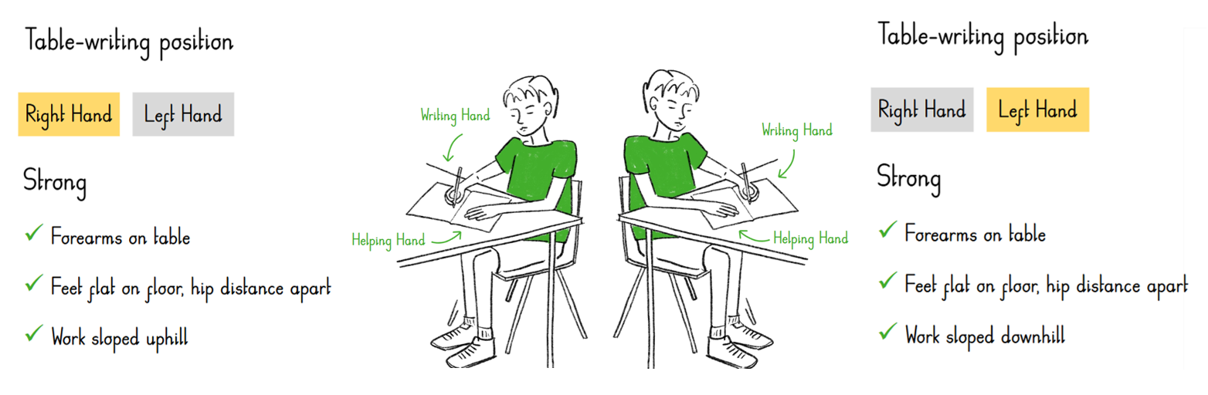
Writing Positions

Slide 11
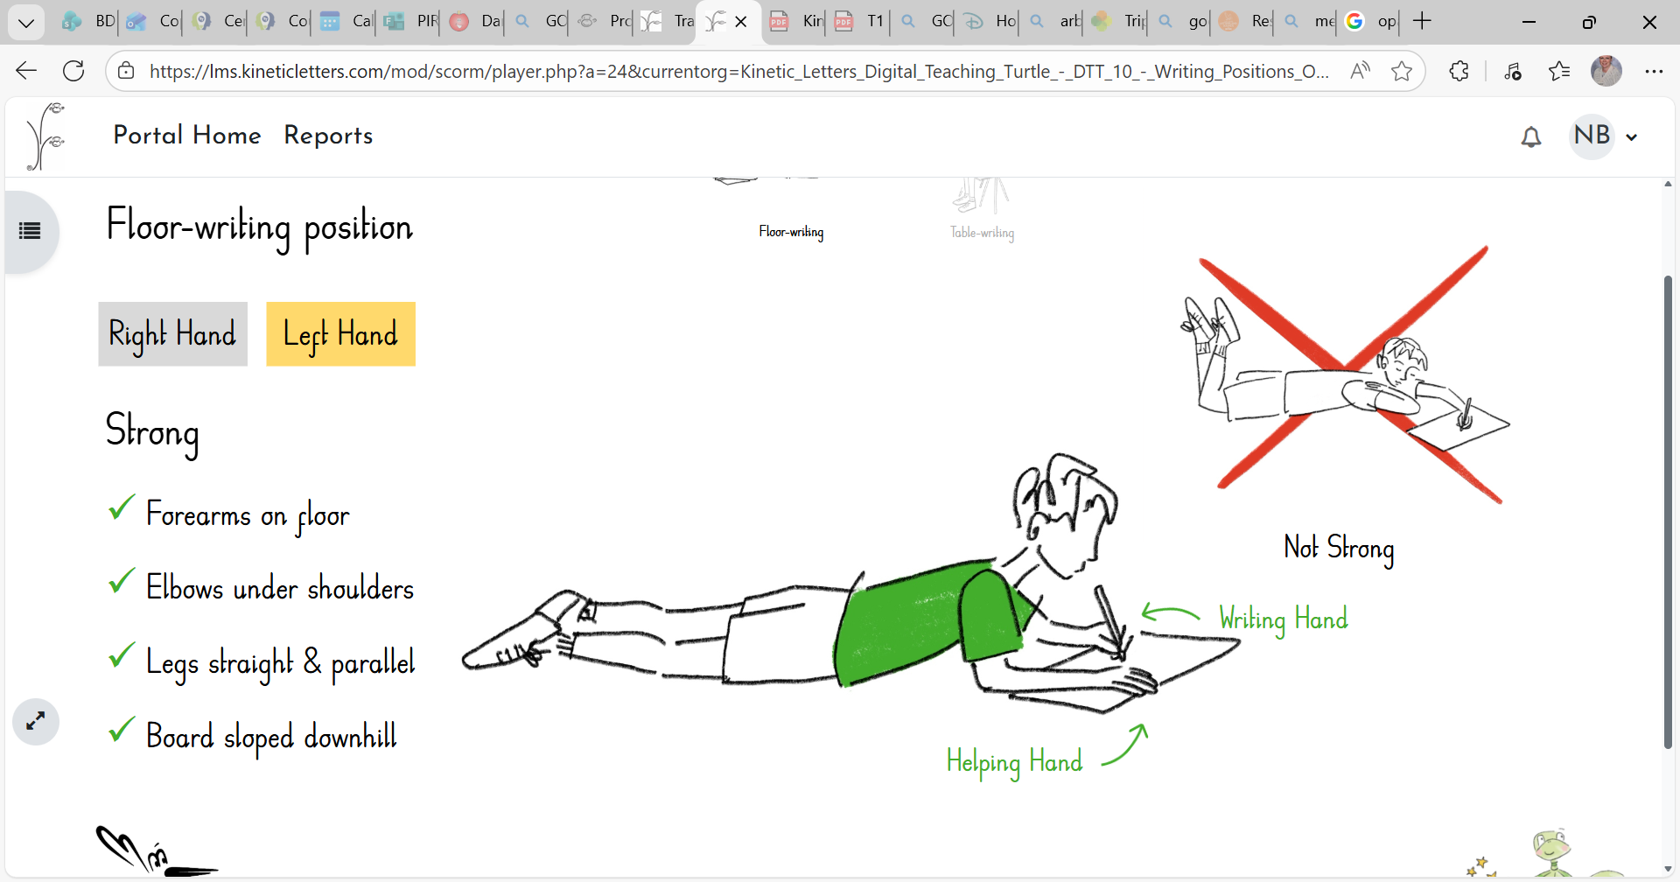
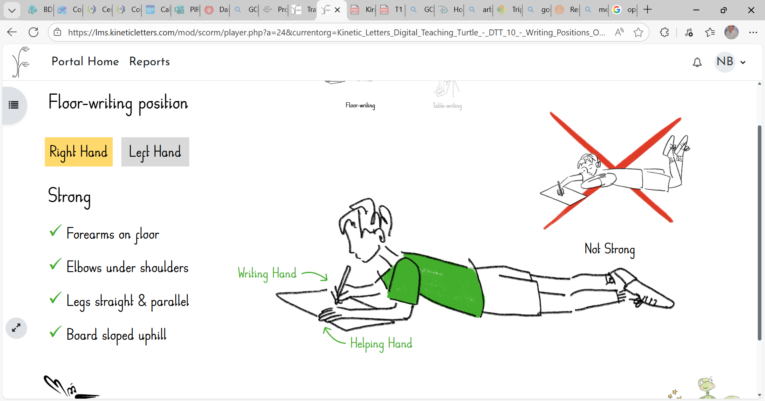
Writing Positions
Notes:
Reasons?

Slide 12
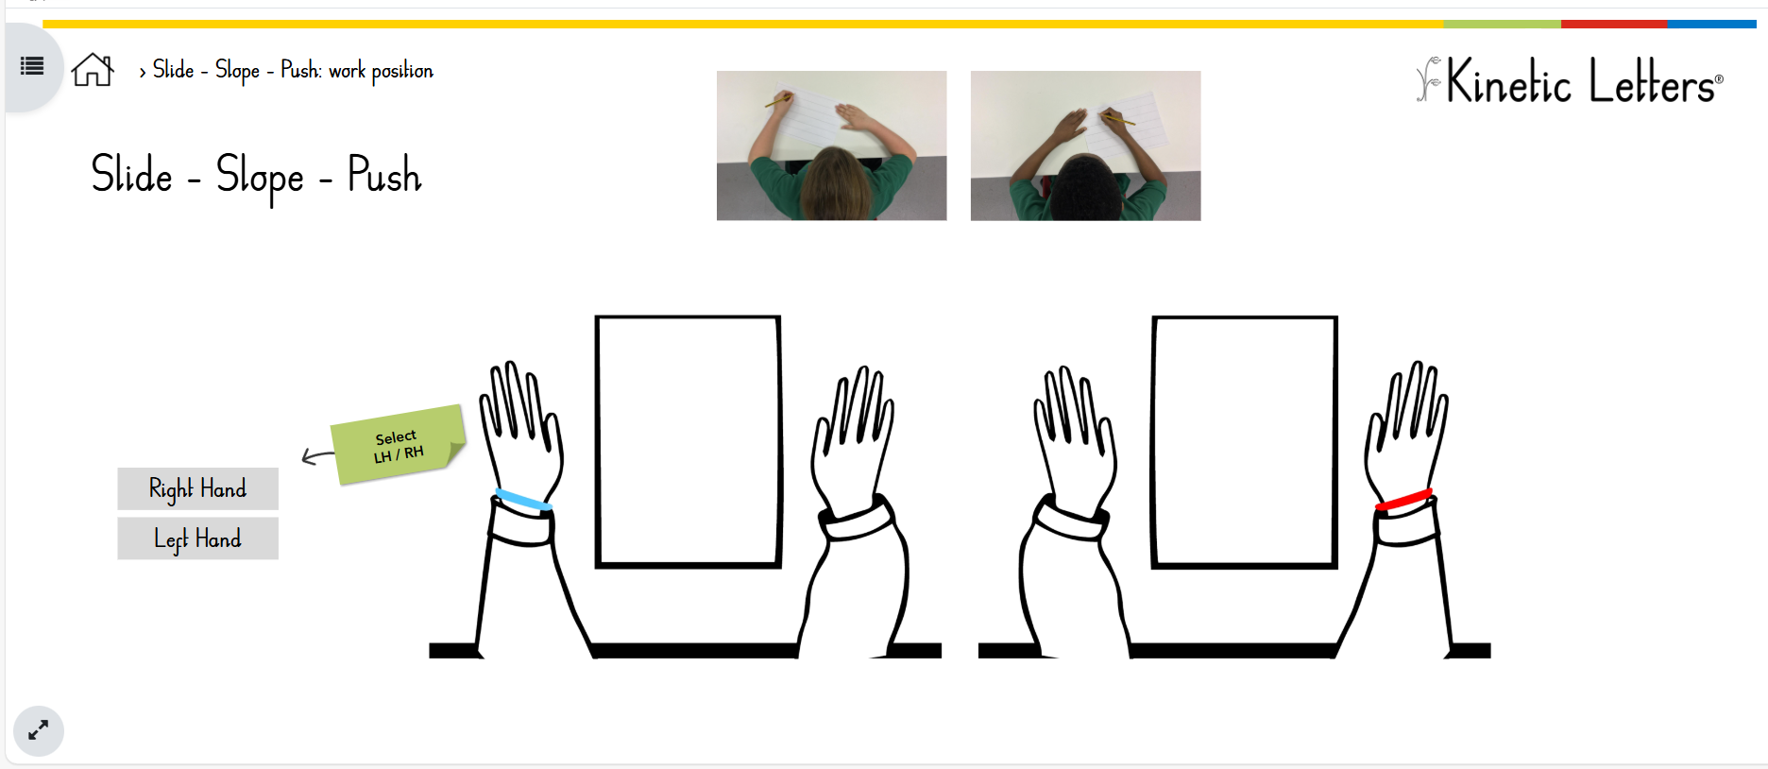
Ready to Write!
DTT V2: DTT 11 Slide – Slope – Push: work position | Kinetic Letters

Slide 13
You have to be strong to write!
The muscles of the hand need strengthening to enable its two main functions of strength and dexterity.
Both are required in order to hold a pencil to write legibly and at speed without physical discomfort.

Slide 14
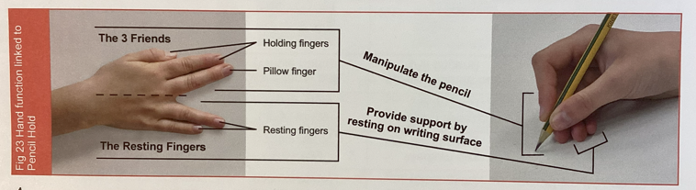
Image 2.11- links to pencil hold pencil hold
Notes:
Know and understand the roles of the fingers and hand.

Slide 15
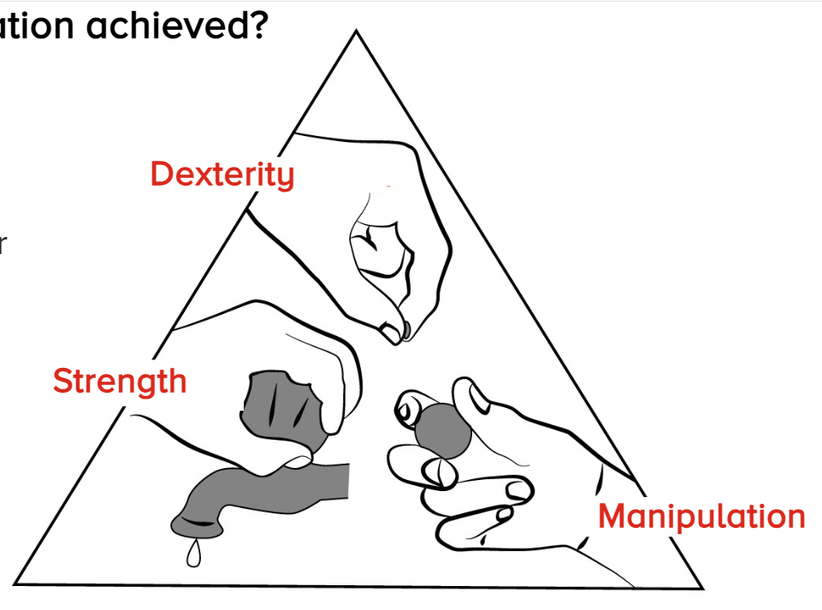
You have to be strong to write!
holding fingers
whole hand
three friends
Notes:
Rice – holding fingers (dexterity – ability for precise hand/finger movements)
Marble – three friends (manipulation – an advanced component of dexterity focussing on moving/adjusting objects,
Tap – whole hand - strength

Slide 16
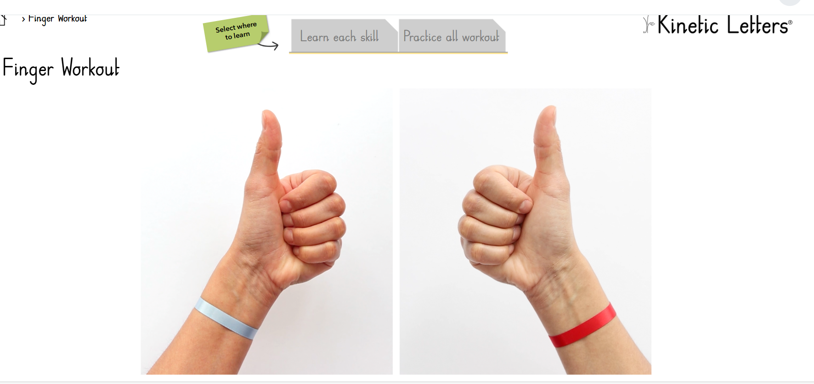
Finger Workout
DTT V2: DTT 9 Finger Workout | Kinetic Letters
Notes:
Use writing hand – not helping hand
Builds strength and dexterity

Slide 17
2. Holding the pencil
The 3 friends pencil hold is the same for right and left-handed writers.
It enables them to write legibly, at a good pace and for extended periods of time.
It makes use of the natural mechanics of how our hands work.
Notes:
This may take time for some children to do – eventually, they will realise that this way is the most comfortable and will allow more dexterity. (Need to build muscle memory. Refer to adults being able to change their habits – e.g. using a potato peeler, chopping an onion correctly) thus this can be changed in children.)

Slide 18
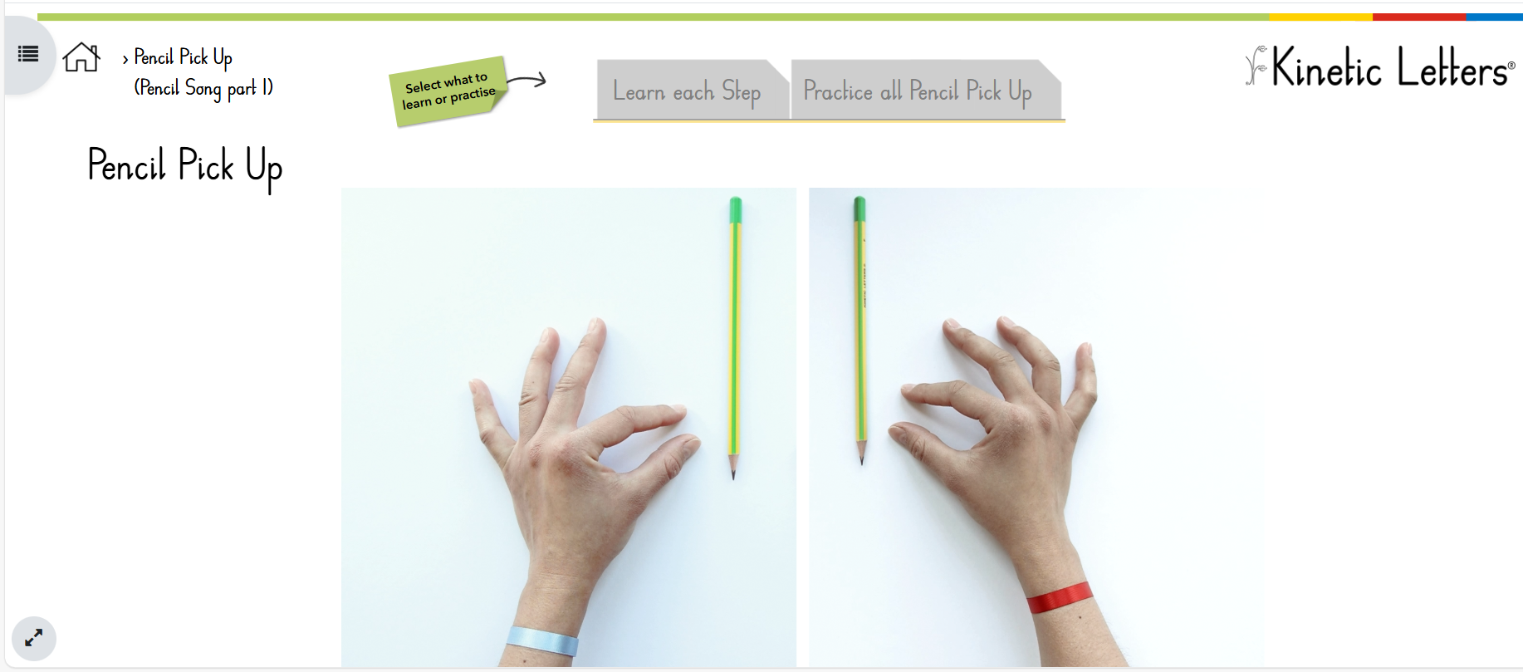
Pencil Pick-Up
An accurate pencil pick up ensures the correct tripod grip, which enables the 3 hand functions of dexterity, manipulation and stability.
DTT V2: DTT 5 Pencil Pick-Up | Kinetic Letters

Slide 19
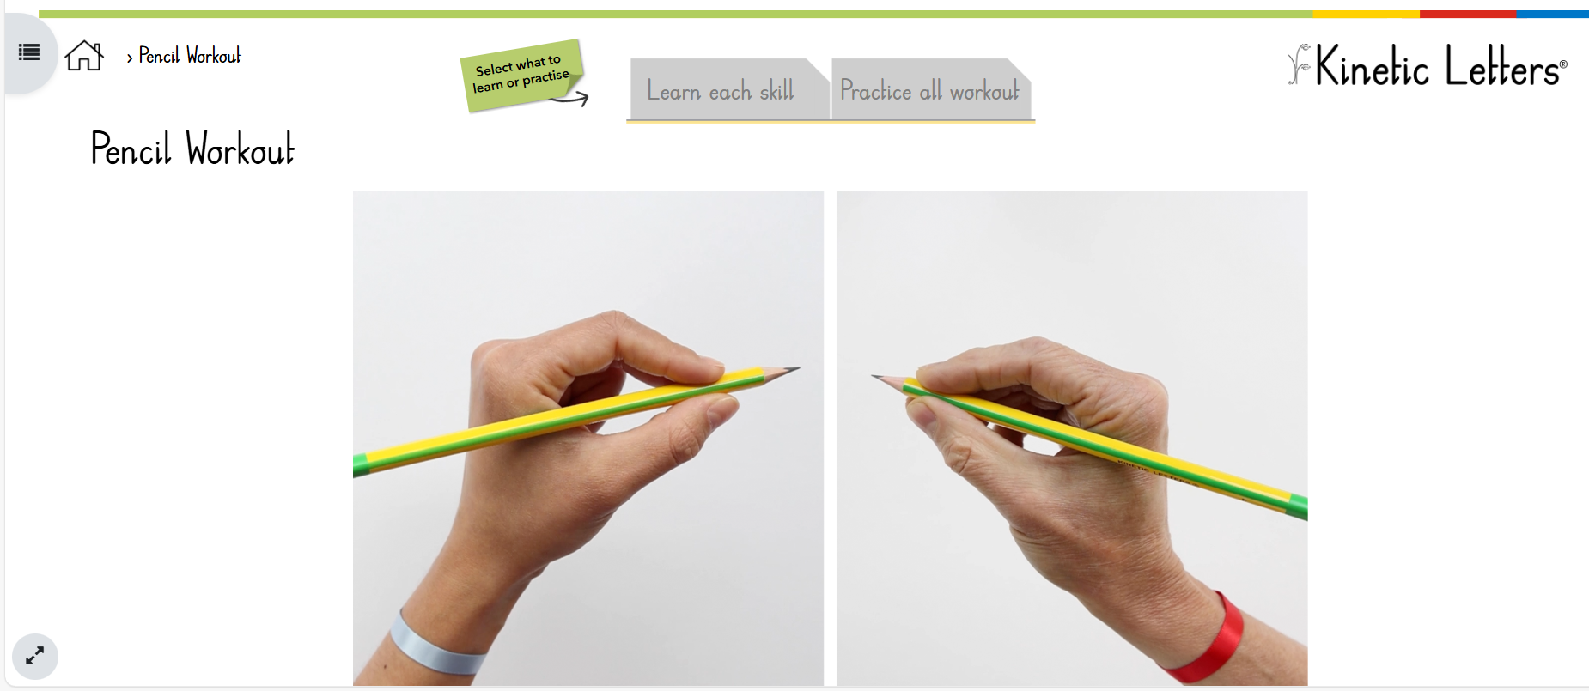
Pencil Workout
DTT V2: DTT 8 Pencil Workout | Kinetic Letters
Notes:
Great way to warm up the fingers

Slide 20
3. Learning the letters
There are 6 moves that are the component parts of letters and numbers.
These are combined into a formation sequence for each letter or number.

Slide 21
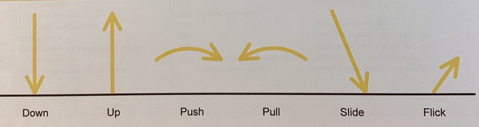

Slide 22
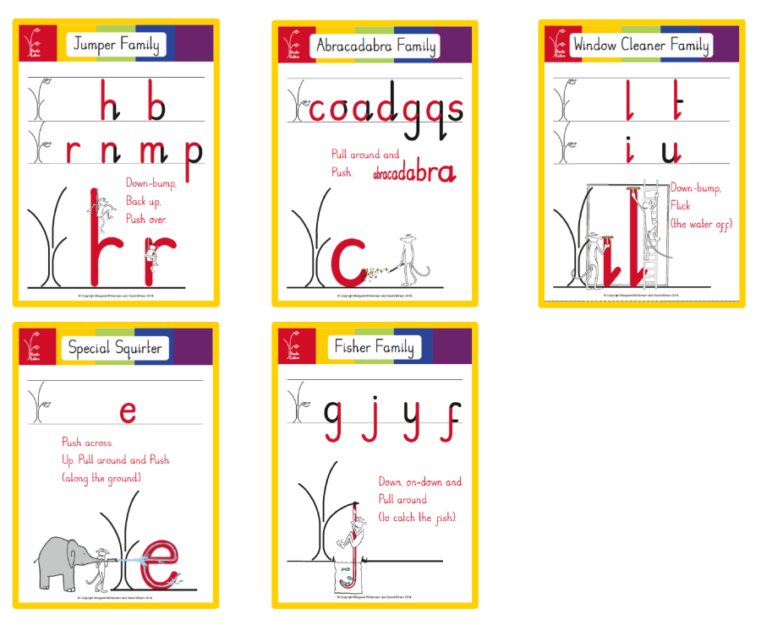
Notes:
Letters arranged into families which share a family feature, making for rapid and accurate learning

Slide 23
Kinetic Letters involves the use of stories and songs to support learning as well as practice in the air, in sand and on whiteboards and paper.
When children are secure with the formation of letters, they will move to joining.
Notes:
Y1 – Y6 will begin introducing the letter families and their formation after Feb Half Term – older chn will love at a faster pace.

