Slide 1

KS1 SATS Meeting

Slide 2
Why are we doing them?
All BDMAT schools are doing them
Children will have rest breaks and will be put into small groups if needed
Used to inform teacher assessments

Slide 3
What tests will they be completing?
- Arithmetic
- Reasoning
- Reading paper 1
Reading paper 2
- SPaG paper
- Spellings
This is used as a supported assessment tool, my teacher assessment overrides this. The more practice, the better ☺
KS1 Year 2 SATs Papers

Slide 4
What could you do at home?
- karate cats
- SATS practice papers
- CGP book
- Children will be sent home with practice questions as homework
https://www.satspapers.org.uk/Page.aspx?TId=4
When are KS1 and KS2 SATs 2025? - Free Primary Resources - BBC Bitesize

Slide 5
What does a y2 writer look like?
Good transcription
Sentences that are coherent and make sense grammatically

Slide 6
Year 2 reading expectations
- Speed of reading (goal is 100 words per minute)
- Comprehension and inference

Slide 7
Use of AI to practice
Copilot: Give me a 200 word extract for a 6 year old. Give me a retrieval and an inference question based on the text

Slide 8
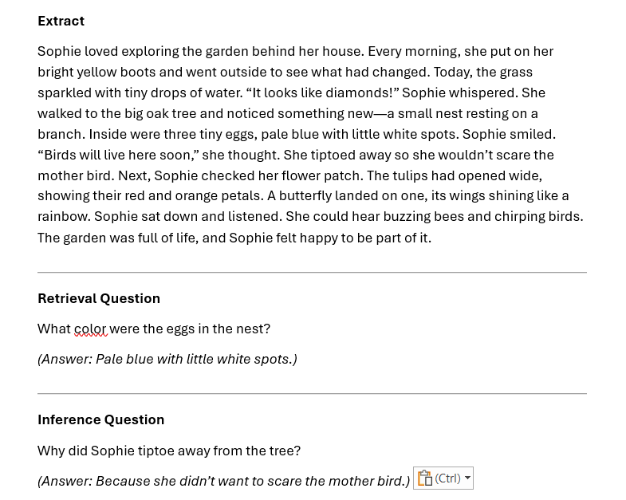
Use of AI to practice
Copilot: Give me a 200 word extract for a 6 year old. Give me a retrieval and an inference question based on the text

