Slide 1






Key Stage 2 SATs 2026
A Presentation to Parents

Slide 2
What are SATs?
SATS: Standard Assessment Tests.
They are compulsory for all Year 6 children.
SATs help teachers – and you - learn more about your child's strengths and areas of development. Headteachers and teachers can compare how well each child is doing with their peers, both in their school and across the country. They can also measure how much each child improves from one Key Stage to another.
Children are tested on what they have been learning at school.

Slide 3
When are SATs?
This year, SATs are the week beginning:
Monday 11th May 2026

Slide 4
The Tests
Monday 11th May | Tuesday 12th May | Wednesday 13th May | Thursday 14th May | Friday 16th May
S.P.A.G. (45 mins) Spelling (20 mins) | Reading (60 mins) | Maths Paper 1: Arithmetic (30 mins) Paper 2: Reasoning (40 mins) | Maths Paper 3: Reasoning (40 mins)
All tests are externally marked.
Writing will be ‘Teacher Assessed’ internally, as in recent years.

Slide 5
Spelling, Punctuation and Grammar
A Spelling test is administered containing 20 words, lasting approximately 20 minutes. (20 possible marks)
A separate test is given on Punctuation, Vocabulary and Grammar (although there are some spelling elements within this).
This test lasts for 45 minutes and requires short answer questions, including some multiple choice. (50 possible marks)
Marks for these two tests are added together to give a total for Spelling, Punctuation and Grammar. (70 possible marks)

Slide 6
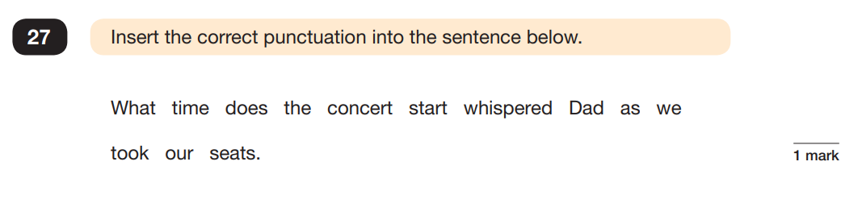
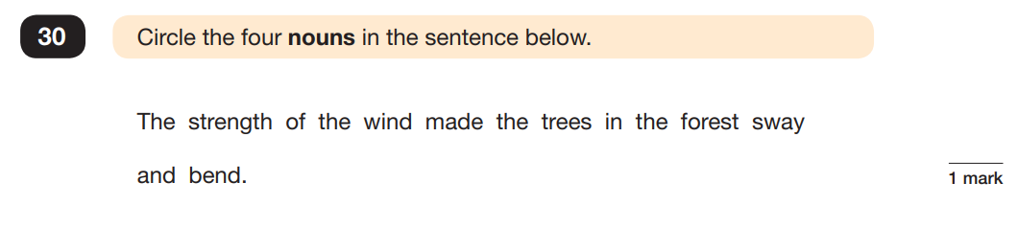
Sample Questions
Grammar, Punctuation and Spelling Paper

Slide 7
Reading
The Reading Test consists of a single test paper with three unrelated reading texts.
Children are given 60 minutes in total, which includes reading the texts and answering the questions.
A total of 50 marks are available.
Questions are designed to assess the comprehension and understanding of a child’s reading.
Some questions are multiple choice or selected response, others require short answers and some require an extended response or explanation.

Slide 8
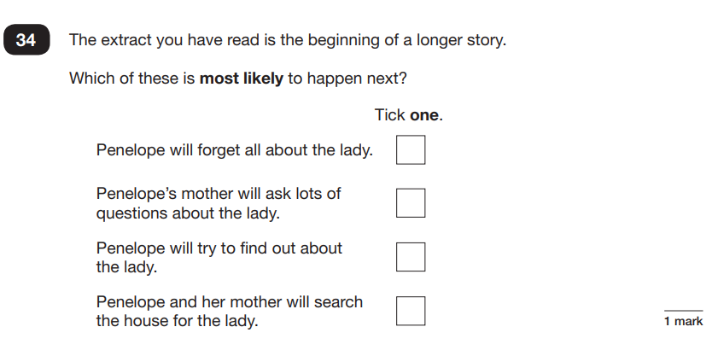
Sample Questions
Reading Paper

Slide 9
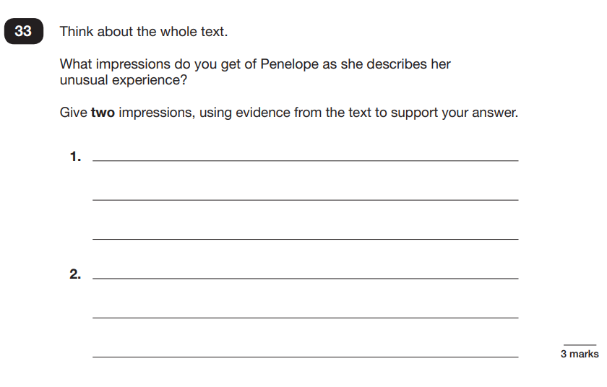
Sample Questions
Reading Paper

Slide 10
Mathematics
Children will sit three tests: Paper 1, Paper 2 and Paper 3.
Paper 1 is for ‘Arithmetic’ lasting for 30 minutes, covering calculation methods for all operations, including use of fractions, percentages and decimals.
Questions gradually increase in difficulty.
Papers 2 and 3 cover ‘Problem Solving and Reasoning’, each lasting for 40 minutes.
Pupils will still require calculation skills but will need to answer questions in context and decide what is required to find a solution.

Slide 11
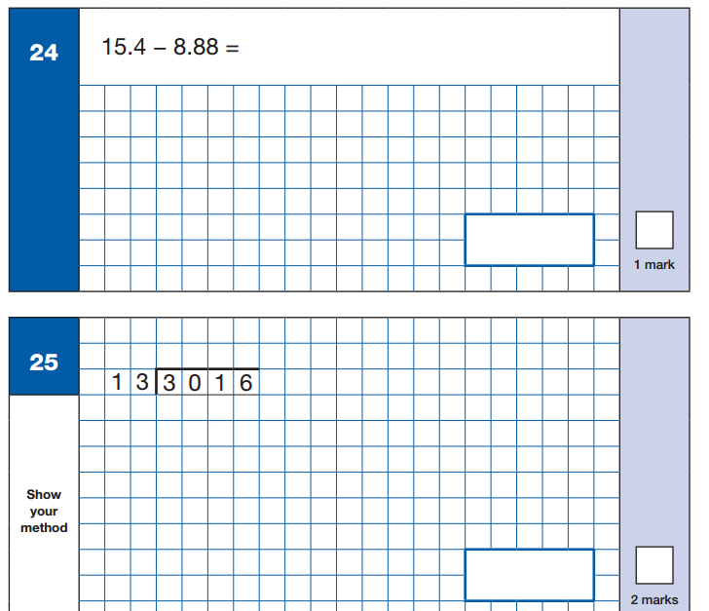
Sample Questions
Maths Paper 1: Arithmetic

Slide 12
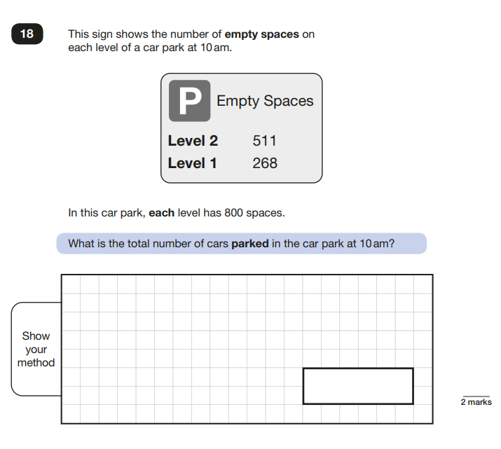
Sample Questions
Maths Paper 2 / Paper 3 : Reasoning

Slide 13
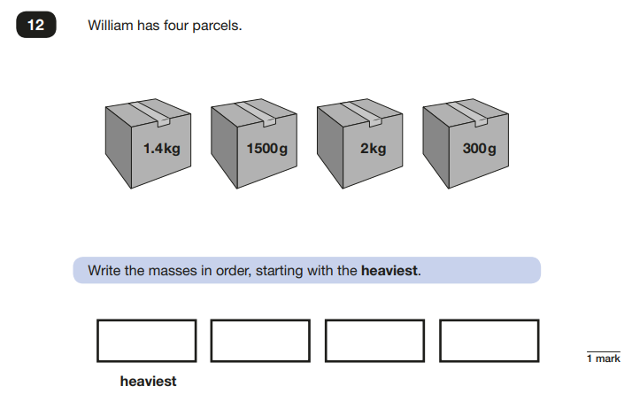
Sample Questions
Maths Paper 2 / Paper 3 : Reasoning

Slide 14
Assessment and Reporting
Test scores are reported as ‘scaled scores’. (You will find these out mid-July.)

Slide 15
Scaled Scores and Examples
What is meant by ‘scaled scores’?
100 will always represent the ‘national standard’.
Each pupil’s raw test score will therefore be converted into a score on the scale, either at, above or below 100.
The scale will have a lower end point of 80 and an upper end point of 120.
A child who achieves the ‘national standard’ (a score of 100) will be judged to have demonstrated sufficient knowledge in the areas assessed by the tests.
A child awarded a scaled score of more than 100 is judged to have exceeded the national standard and demonstrated a higher-than-expected knowledge of the curriculum for their age.
A child awarded a scaled score of less than 100 is judged to have not yet met the national standard and performed below expectation for their age.
NB: The raw test score equalling a scaled score of 100 varies each year.
(2023 it was 24/50)
Reading 2025
Raw Score /50 | 9 | 15 | 21 | 28 | 31 | 35 | 40 | 44
Standardised Score | 86 | 91 | 95 | 100 | 102 | 105 | 110 | 114

Slide 16
Scaled Scores and Examples
Mathematics 2025
Raw Score /110 | 24 | 34 | 46 | 58 | 71 | 82 | 95 | 104
Standardised Score | 91 | 94 | 97 | 100 | 103 | 106 | 110 | 115
SPAG 2025
Raw Score /70 | 17 | 22 | 29 | 35 | 41 | 47 | 54 | 60
Standardised Score | 91 | 94 | 97 | 100 | 103 | 106 | 110 | 115

Slide 17
Higher Attaining Pupils
There are no separate tests for the most able children.
Instead, each test will have scope for higher attaining pupils to show their strengths.
For those with a scaled score of 110 or more in a subject, they are judged to be working at ‘greater depth’ within the national standard (demonstrating a higher than expected and deeper knowledge of the curriculum for their age).

Slide 18
Writing
As has already been stated, writing will be ‘Teacher Assessed’ internally, as in recent years.
Teacher assessment is what teacher’s do as part of their everyday practise. In our teaching, we assess learners’ progress in all areas of the curriculum.
Your child’s teacher will assess their writing compositions against a framework which is split into three standards. Each standard contains a list of ‘I can’ statements.
To demonstrate that a pupil has met a standard, evidence is needed that the pupil demonstrates attainment of all of the statements within that standard and the statements in the preceding standard(s).
working towards the expected standard | I can use capital letters, full stops, question marks, commas for lists and apostrophes for contraction mostly correctly.
working at the expected standard | I can use a range of devices to build cohesion (e.g. conjunctions, adverbials of time and place, pronouns, synonyms) within and across paragraphs
working at greater depth within the expected standard | I can demonstrate a conscious control over levels of formality, particularly through manipulating grammar and vocabulary to achieve this.

Slide 19
Writing
Your child’s result for English writing will be a judgement of their work across Year 6 (particularly work produced towards the latter end).
This judgement will be subject to possible external moderation.

Slide 20
How to Help Your Child
Support and reassure your child that there is nothing to worry about and they should always just try their best.
Encourage your child to believe in themselves, ‘You can do it!’
Ensure your child has the best possible attendance at school.
Support your child with any homework tasks.
Ensure children are reading regularly at home for more extended periods (stamina is needed for the Reading paper).
Make sure your child has a good sleep and healthy breakfast every morning.
Remind your child that the tests are important, but that they are not the only way they are to be measured. We don’t want child panicking or worried, we want them to be prepared.

Slide 21
Booster Sessions
These will run after school, between 3pm and 4pm, on Tuesdays and Thursdays (beginning Tuesday 27th January and ending Thursday 7th May).
The aim of these sessions is to help children feel confident in both their understanding of the curriculum and the process during this week of formal testing.
Children will revisit topics that they are unsure of and also look at ‘test techniques’ (i.e. how questions are worded, how to answer the different types of questions, what the marking system means etc.)
Children will work on Maths on a Thursday and Reading on a Tuesday.
Booster sessions will be taught in groups of different sizes, based on ability.
Teaching will be informal and relaxed.
Attendance is crucial.

