Slide 1
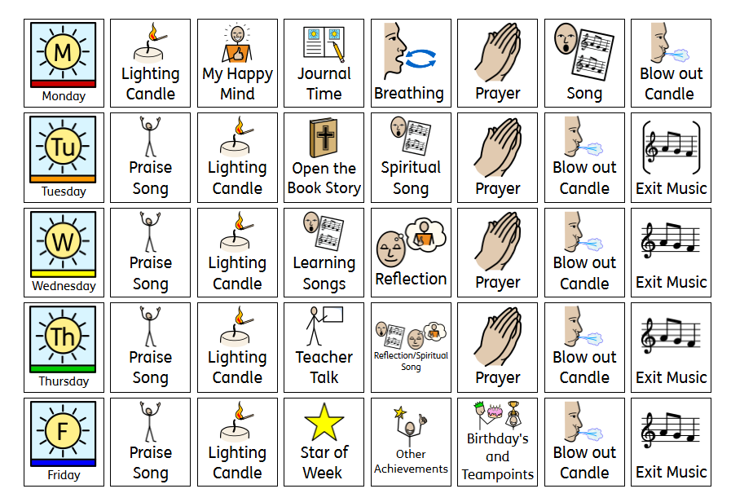

Slide 2
Thursday God’s World
Proverbs 12:10 (NIV)
"The earth is the Lord’s, and everything in it, the world, and all who live in it."
God made the world and everything in it therefore looking after it and each other is our responsibility to teach the children.

Slide 3
Worship Songs to learn this half term:
10,000 reasons- Capitol Kids
Lyric Video for "10,000 Reasons (Bless The Lord)" by Capitol Kids!
Sling Shot- Worship for everyone.
Slingshot (Music Video) - Nick & Becky Drake (Worship For Everyone) (ACTIONS)
Nothing is Impossible- Planet Shakers
Nothing is Impossible - Planetshakers (Worship with lyrics) (Feat. Israel Houghton)
Way Maker- Leeland (Kids Version)
Way Maker - Leeland | LYRIC VIDEO
Bible Story-Fruit of the Spirit- Uncle Charlie
Fruit of the Spirit | Full Preview | Uncle Charlie Songs - YouTube
Worship Songs we know:
God is Good- Worship for everyone
God is Good - Nick and Becky Drake (Worship for Everyone)
Move- Worship for everyone
Move (Official Actions Video) - Worship For Everyone
Hope- Worship for everyone
Hope - Worship For Everyone (Action Video)
One Way Jesus- Hillsong Kids
Hillsong Kids One Way
Values- Let our Love Show/ Songs for School
Let Our Love Show by Songs for School ft. the Schools of St Alphege

Slide 4
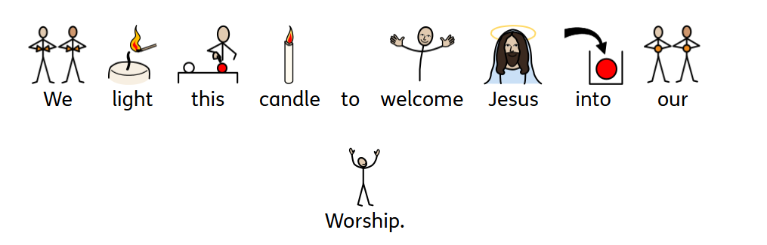

Slide 5

Our Value is…
Hope
Anything is possible when we faith.
The Healing Touch of Jesus (Luke 6:19)

Slide 6

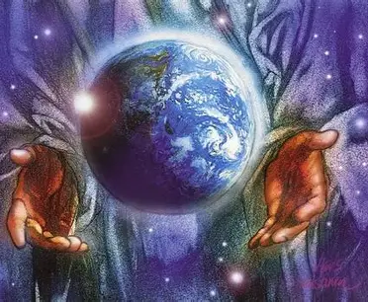
God’s World Worship
Picture News – YouTube
Opal
Sustainability
Value based

Slide 7


Woodside Wows and Owls.
“Spirituality means thinking about life’s big questions and what really matters to us.”
"Wows" represent moments of awe, wonder, and inspiration — times when pupils and staff experience excitement and appreciation for learning, creativity, or discovery.
"Owls" symbolise wisdom, reflection, and the pursuit of deeper understanding. They encourage individuals to seek knowledge, use sound judgment, and approach challenges with insight and confidence.
Peace Out Guided Relaxations for Kids | Mindfulness & Calm with Jaime 💫 – YouTube
The Mindfulness Teacher – YouTube
Self-Image and Self-Esteem | Self-Awareness Exercises For Kids | GoNoodle - YouTube
Spiritual Song

Slide 8

Let’s pray together…

Slide 9
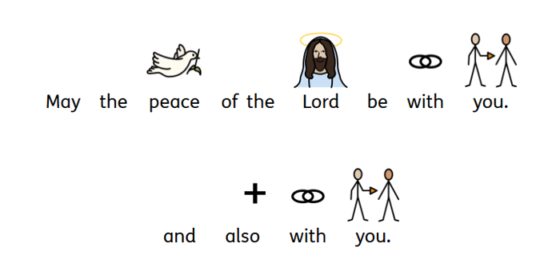
Sending out…

Slide 10
Worship Songs to learn this half term:
10,000 reasons- Capitol Kids
Lyric Video for "10,000 Reasons (Bless The Lord)" by Capitol Kids!
Sling Shot- Worship for everyone.
Slingshot (Music Video) - Nick & Becky Drake (Worship For Everyone) (ACTIONS)
Nothing is Impossible- Planet Shakers
Nothing is Impossible - Planetshakers (Worship with lyrics) (Feat. Israel Houghton)
Way Maker- Leeland (Kids Version)
Way Maker - Leeland | LYRIC VIDEO
Bible Story-Fruit of the Spirit- Uncle Charlie
Fruit of the Spirit | Full Preview | Uncle Charlie Songs - YouTube
Worship Songs we know:
God is Good- Worship for everyone
God is Good - Nick and Becky Drake (Worship for Everyone)
Move- Worship for everyone
Move (Official Actions Video) - Worship For Everyone
Hope- Worship for everyone
Hope - Worship For Everyone (Action Video)
One Way Jesus- Hillsong Kids
Hillsong Kids One Way
Values- Let our Love Show/ Songs for School
Let Our Love Show by Songs for School ft. the Schools of St Alphege

