Slide 1
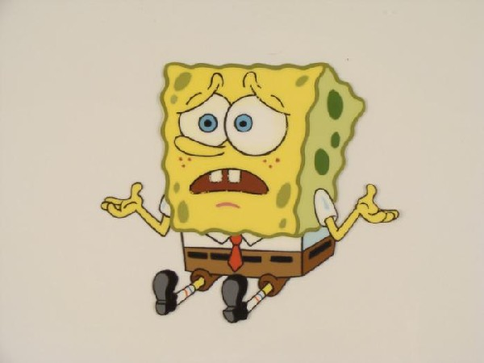
What on Earth is Tessellation?
A tessellation is created when a shape is repeated over and over again covering an area without any gaps or overlaps.

Slide 2
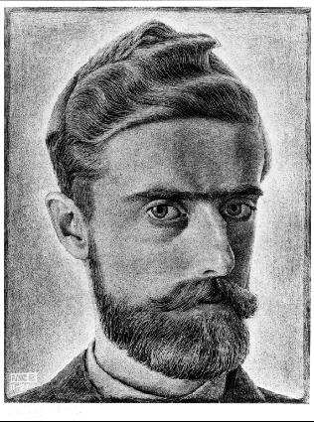
M.C Escher
Maurits Cornelis Escher, usually referred to as M. C. Escher, was a Dutch graphic artist. He is known for his often mathematically inspired tessellations.
Let’s take a look at some of his work…

Slide 3
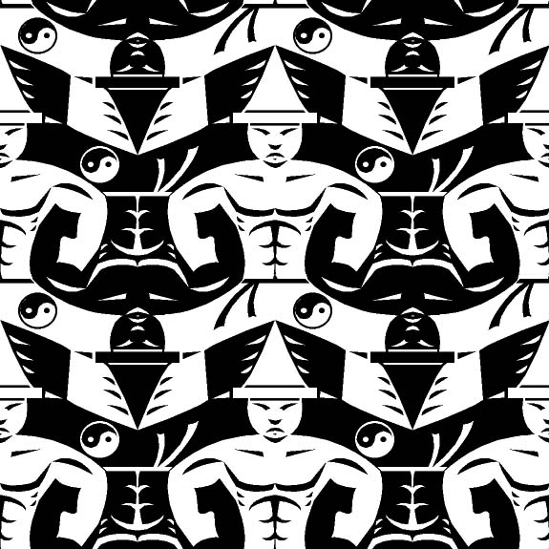

Slide 4
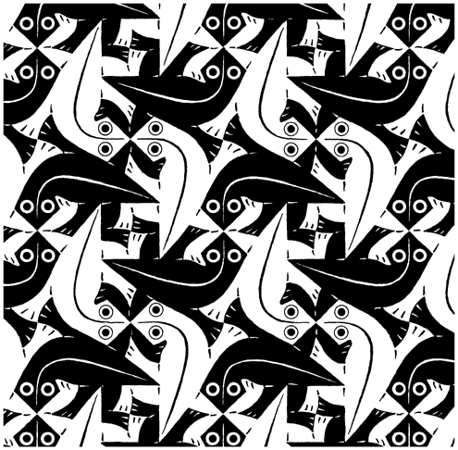

Slide 5
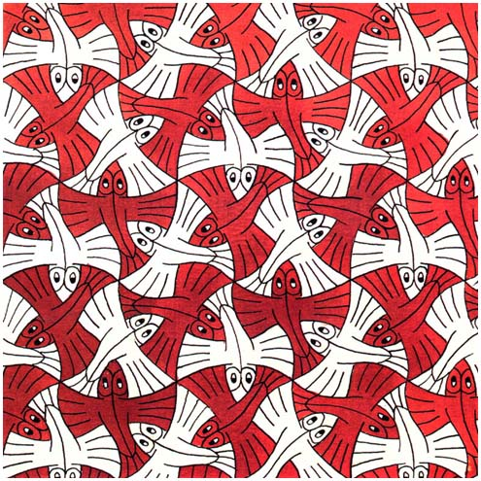

Slide 6
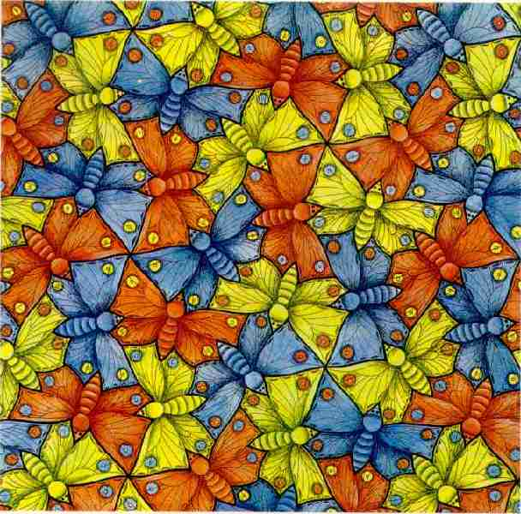

Slide 7
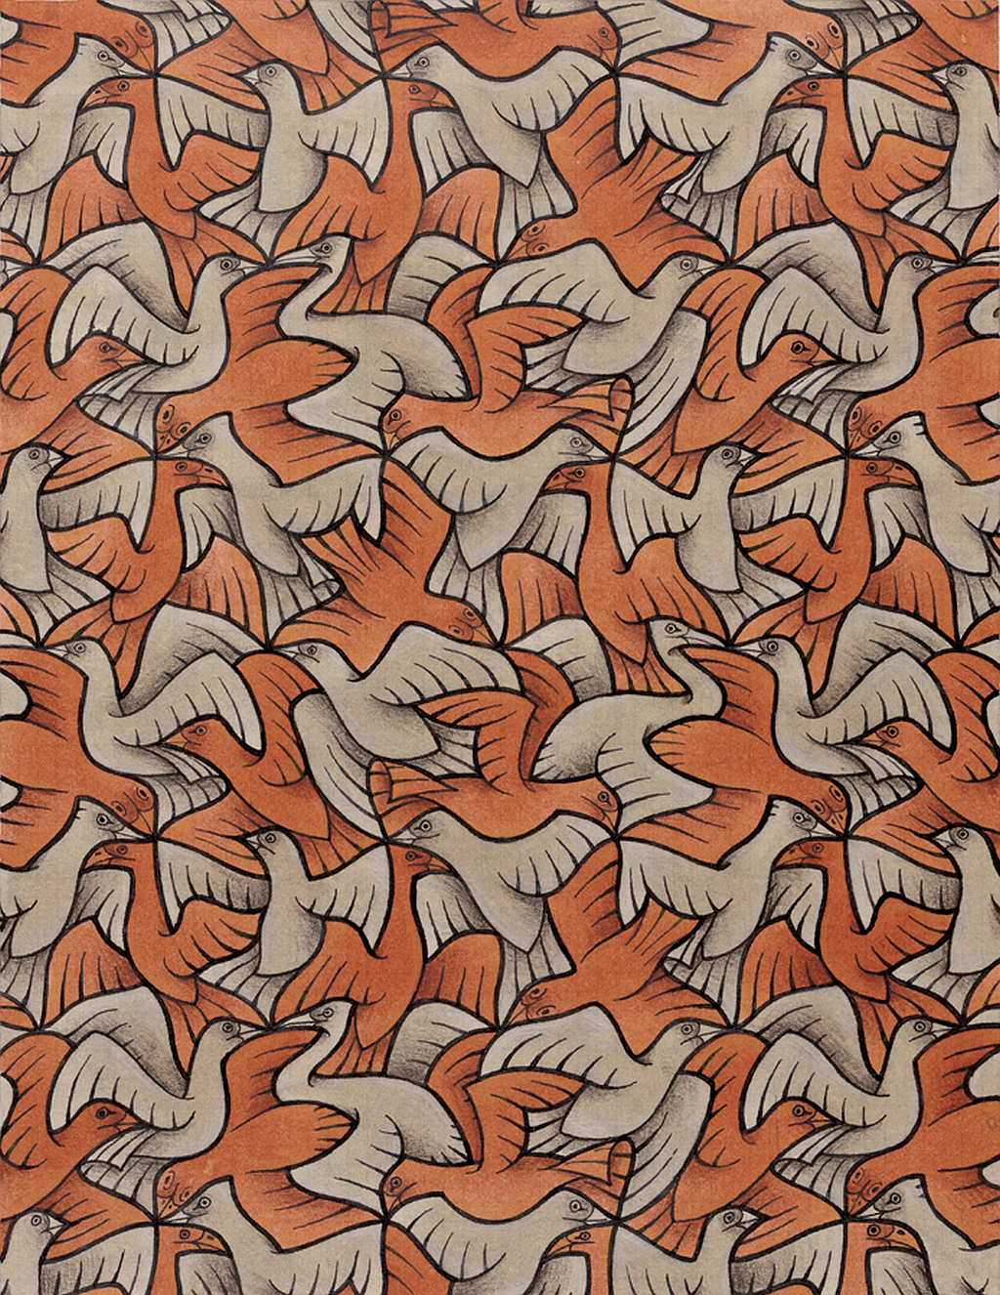

Slide 8
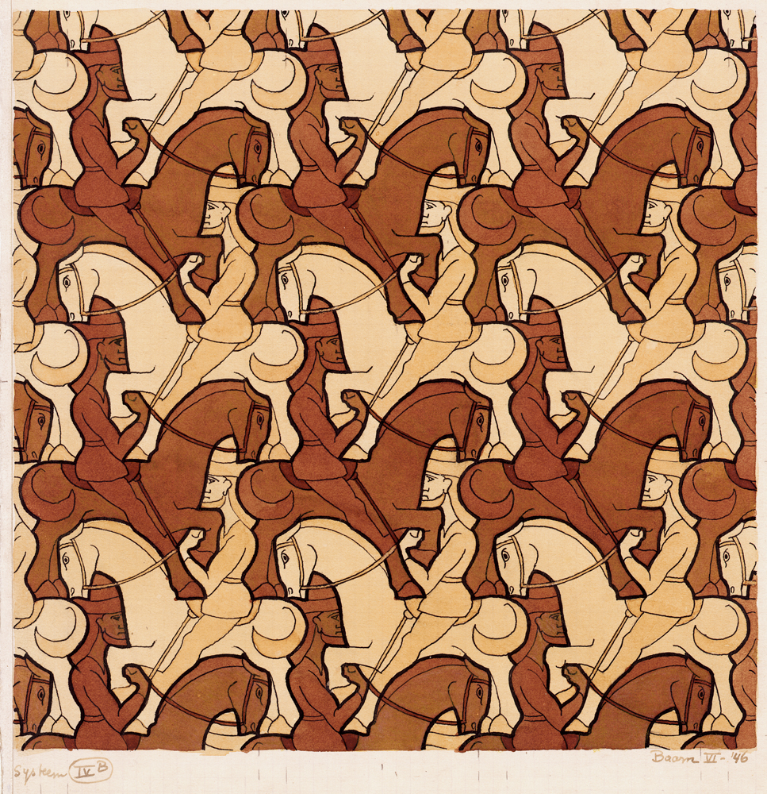

Slide 9
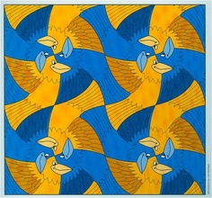

Slide 10
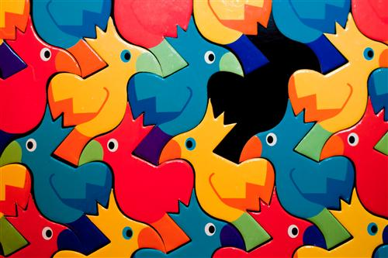

Slide 11
Where do we see tessellation in everyday life?

Slide 12
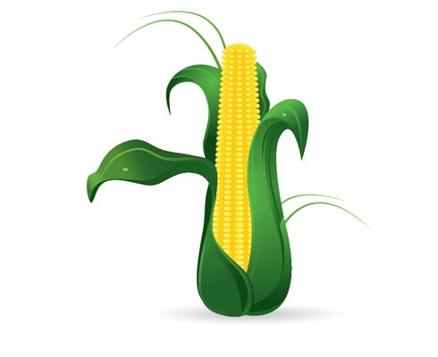
Corn on the cob

Slide 13
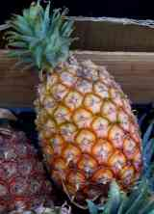
Pineapple

Slide 14
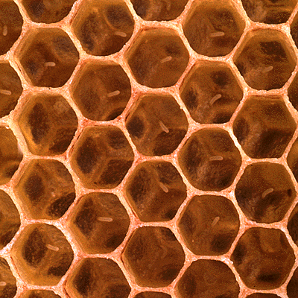
Honeycomb

Slide 15
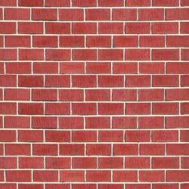
Brick Laying

Slide 16
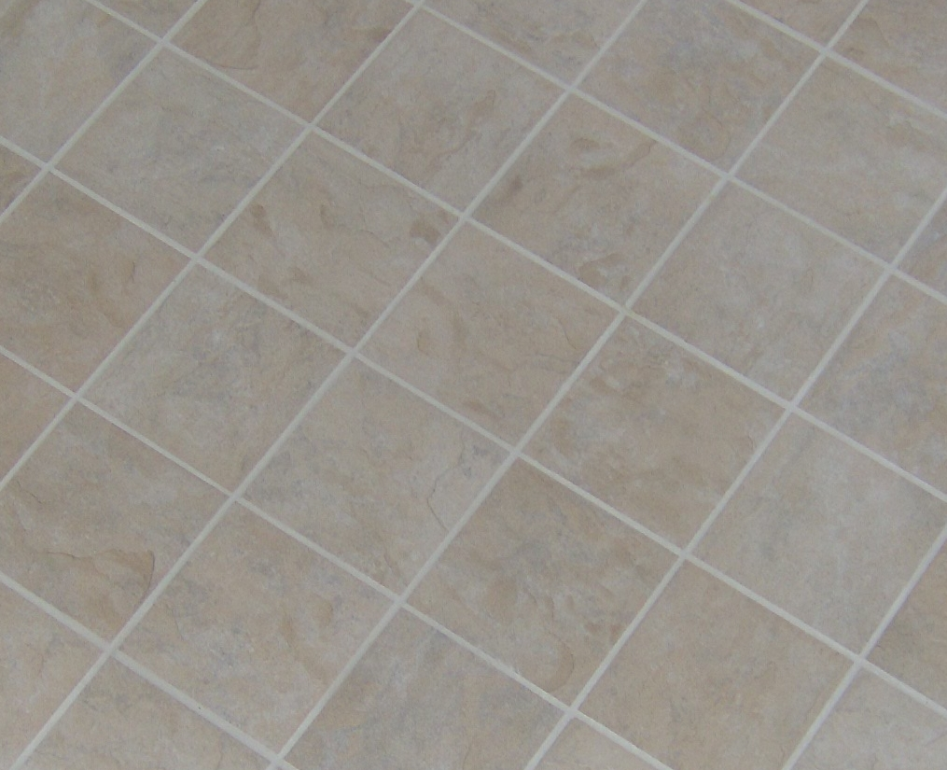
Floor Tiles

Slide 17
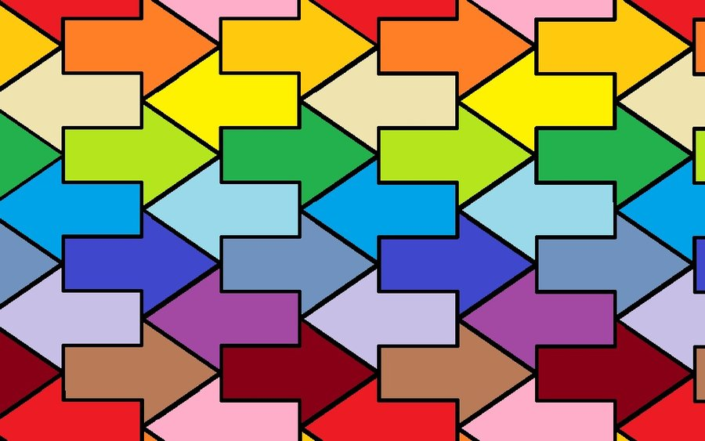
Your challenge

Slide 18
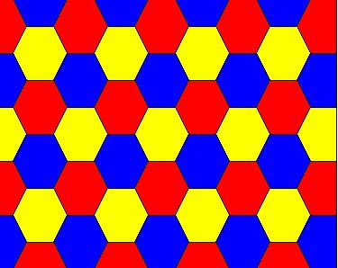

Slide 20
Get creative!
https://www.youtube.com/watch?v=WBVzoaFi90E

