Slide 1
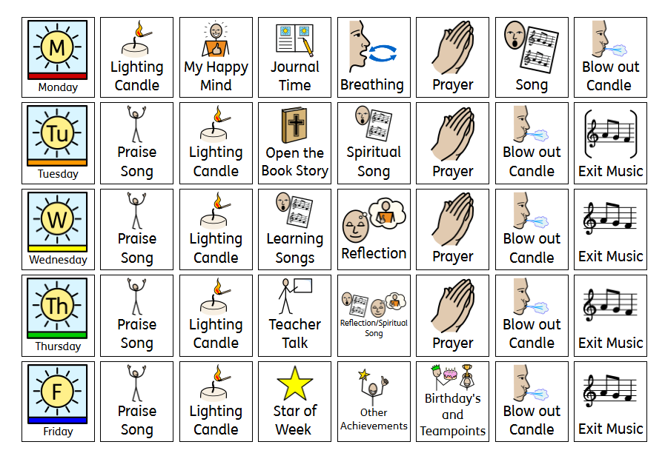

Slide 2
Worship Songs
Praise- God is Good- Worship for everyone
God is Good - Nick and Becky Drake (Worship for Everyone)
Spiritual- Here I am to Worship – Tim Hughes (Kids Version)
Here I am to Worship lyrics / music video - Tim Hughes
Values- Justice/Songs for School.
Justice I Official Lyric Video I Songs For School #justice #empowerment
Bible story- Pharoh Pharoh Let my People Go!
Pharaoh Pharaoh

Slide 3
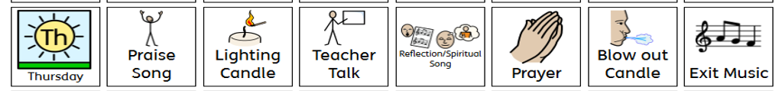

Slide 4
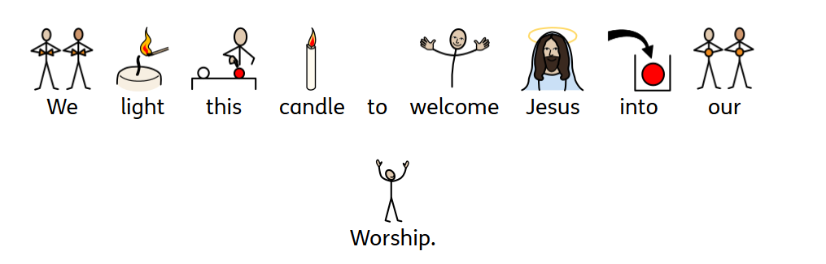

Slide 5

to take part in Worship.
to our Woodside Family.
so everybody feels welcome.

Slide 6

Our Value is…
Challenging Injustice
With our true morals and values we know what is right and challenge what is not.

Slide 7

Picture News - YouTube

Slide 8
Reflection
Peace Out Guided Relaxations for Kids | Mindfulness & Calm with Jaime 💫 – YouTube
The Mindfulness Teacher – YouTube
Self-Image and Self-Esteem | Self-Awareness Exercises For Kids | GoNoodle - YouTube

Slide 9


Slide 10
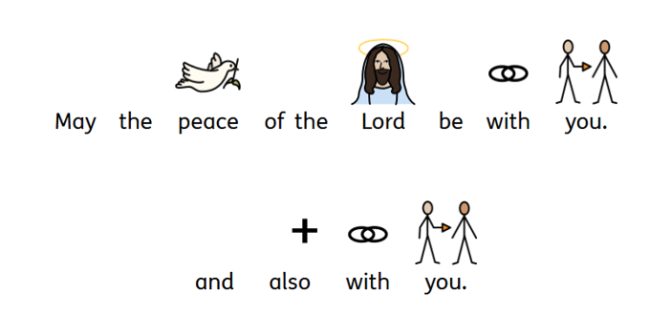

Slide 11
Worship Songs
Praise- God is Good- Worship for everyone
God is Good - Nick and Becky Drake (Worship for Everyone)
Spiritual- Here I am to Worship – Tim Hughes (Kids Version)
Here I am to Worship lyrics / music video - Tim Hughes
Values- Justice/Songs for School.
Justice I Official Lyric Video I Songs For School #justice #empowerment
Bible story- Pharoh Pharoh Let my People Go!
Pharaoh Pharaoh

