Slide 1

EYFS/KS1/KS2
Parent Meeting
Woodside C of E Primary School
‘Together in God’s love we inspire and grow through living life in all its fullness’

Slide 2
OUR VISION and MOTTO
‘Together in God’s love we inspire and grow through living life in all its’ fullness’
John 10:10
Notes:
Working together, in partnership – parents, children, BDMAT, community
Importance of growth, inspiring and loving one another and living life in all its’ fullness- about happy , well-rounded children, who enjoy success and positive well-being.

Slide 3
OUR SCHOOL VALUES
HOPE
LOVE
FORGIVENESS
RESPECT
CHALLENGING INJUSTICE
Notes:
We expect chn to live out our values and we model them as staff. Importance as a faith school.

Slide 4
OUR SCHOOL RULES
READY
RESPECTFUL
SAFE
Notes:
Chn know the rules and what is expected of them.

Slide 5
OUR SCHOOL’S GROWTH
SRP – Specialist Resource Provision (8 Children)
Nursery :
Roots: 2/3 year old (8 Children)
Shoots: 3/4 (26 children, full or part time)
Notes:
Throughout the summer, the school has undergone a lot of changes.
SRP – communication and interaction hub for children with autism and EHCPs who need specialist support
Nursery
Tours will be offered once all children are settled into the academic year to aww these change

Slide 6
Our School Improvement Priorities 25-26
Ensure all pupils ‘belong’ and thrive in every lesson through quality adaptive teaching.
Embed the quality of the depth, breadth, and coverage of the curriculum. (focus on Art, DT and R.E
Further embed the quality of teaching, learning and assessment to improve the combined % in R, W and M in all year groups.
Ensure maths teaching builds on previous learning to enable all pupils to make good or better progress
Implement a Nursery provision that allows pupils to flourish and succeed.
Notes:
These are our SIP priorities for this academic year. As a school this is what we will be working on.

Slide 7
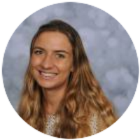
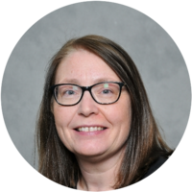
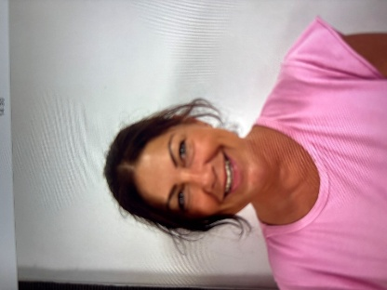

Team
Class Teacher- Miss Groucott
Support Staff- Mrs Hancox and Mrs Wilson
PPA cover- Mr Lavis
Friday Mornings.
(Music and Computing)

Slide 8

Curriculum
Overviews
School Calendar of Events
Notes:
Over the next few weeks, overviews for each year group will be available on the website stating what Topics/Themes children will be covering and outcomes they will be producing in all subjects.
‘School Calendar of Events’ has gone out detailing parent workshops, special days, parents’ meetings – aim to work together

Slide 9

Our Curriculum
New Beginnings
Notes:
Ongoing aim to create a bespoke curriculum for our children.
Introduction of a new Art and D&T curriculum – in consultation with an external advisor
PSHE – after effective implementation of My Happy Mind, we will now be utilising My Happy Mind Plus as our PSHE scheme
New RE Scheme – to reflect the needs of our children, KS1 will focus on Islam and Christianity and KS2 Humanism (a non religious approach to life), Sikhi and Christianity
Forest School offer – ½ a term for each year group Y1 – Y6 chn, with time at the end of the year for Reception.

Slide 10
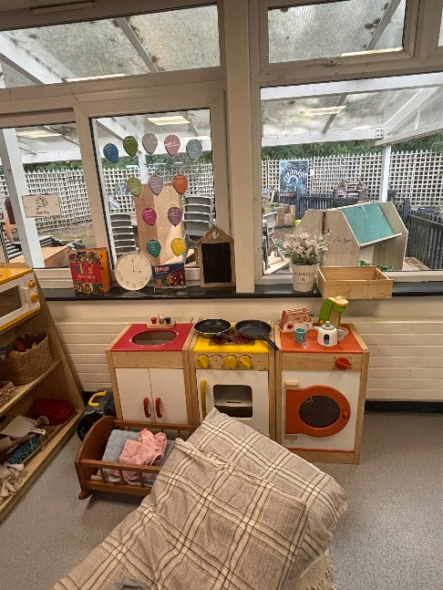
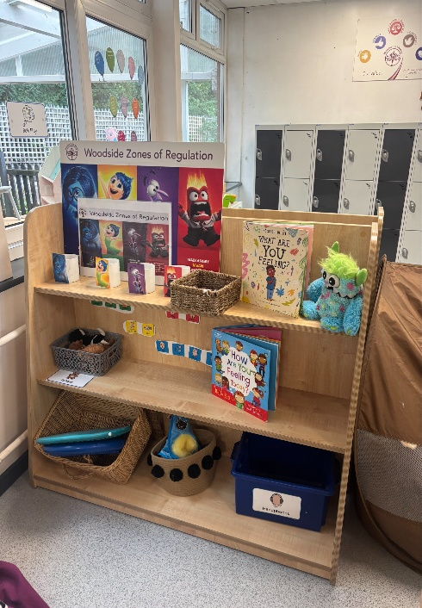
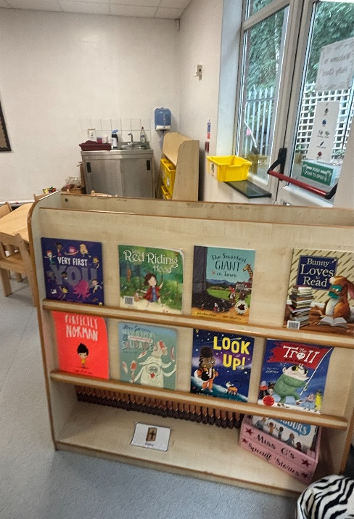
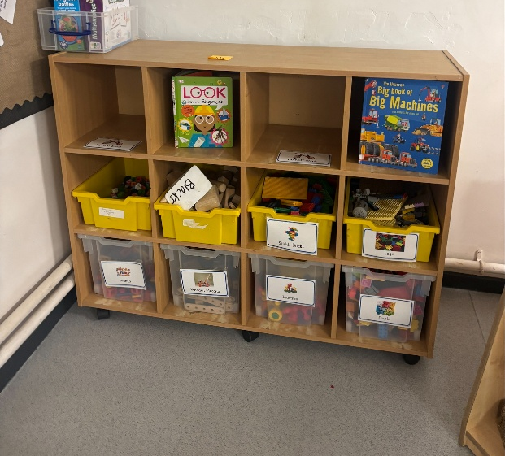
Continuous provision refers to all of the different provision areas (e.g. small world, water, maths, art, science, construction, role play and outdoors), learning opportunities and resources which are available for the children in your class to use. It should be linked to children's needs and interests and build on the learning happening in your class. Continuous provision should provoke learning, motivate and challenge children.
Outside area coming soon!

Slide 11
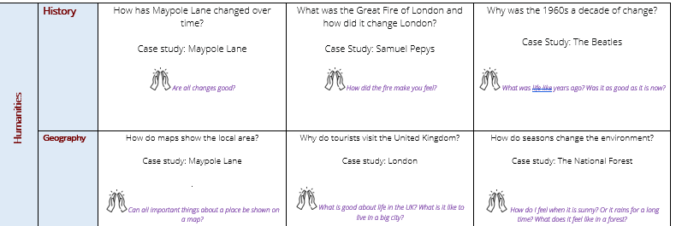
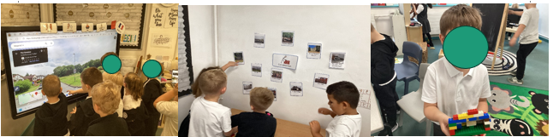

Slide 12
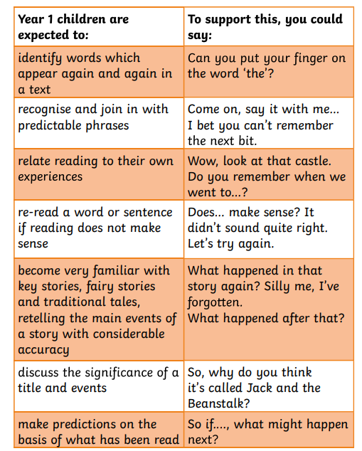
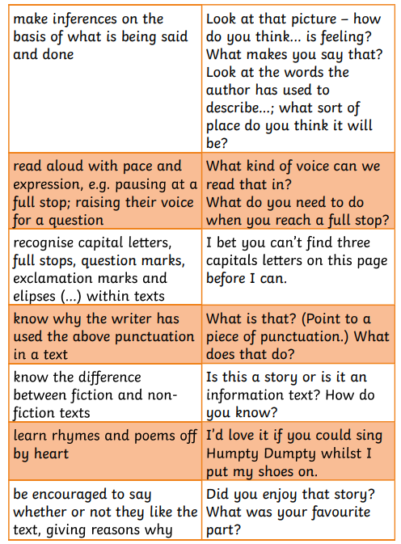

Slide 13


Slide 14


Parent meeting nearer the time ☺
Notes:
Meeting nearer the time.

Slide 15
Reading Routines
Monday- Homework sheet, LW reading book handed out.
Friday- Little Wandle Book collected in. Sharing book given out and swapped over the following week.
Please bring folders in each day ☺

Slide 16
Children need each day…
Reading folder with their reading diary and book in. Sharing books in bags for Friday.
All clothing to be named.
Spare set of clothes in case of accidents.
Named water bottle.
Our PE days are Tuesdays and Fridays.

Slide 17
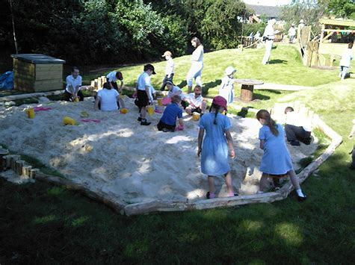
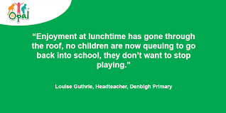
LUNCHTIMES
OPAL PROVISION
Notes:
Opal-All about play opportunities for all.
TAs /LSAs continue to oversee lunchtimes to improve lunchtime behaviour, relationships and provision. Since introducing, this has had positive improvements and a huge impact so far. SLT also on duty.
Coat/waterproof and wellies/outdoor footwear needed in school please.

Slide 18

SEND SUPPORT
Notes:
Along with Mrs Johnson, SEND team is made up of Miss Orgill – SENCo and Mrs Day - SENCO Assistant and Pastoral Lead (pastoral = focus on supporting a child’s overall well being)
SEND chn are supported through learning plan targets which are set and reviewed termly. Some chn need further support and have Educational Health Care Plans or on the pathway to receiving one. We have a school SALT, Play Therapist and OT who we pay for privately as a school as well as an Ep a private to support our chn and give them the right support they need.
Nurture runs every afternoon for chn who need emotional and social support – in Sunshine Room. Mrs Day and Mrs Logan leading.
Mrs Logan, Mrs Day and Mrs Sadler undertaking ELSA training (ELSA – Emotional, Learning Support Assistant)

Slide 19
UNIFORM
-LABELS
-HAIR UP
-PE SESSIONS
-EARRINGS
Notes:
Please ensure children are wearing the correct uniform – preparing them for high school.
Stud earrings – to be taken out/covered for PE
Hair up for PE sessions
Belongings labelled

Slide 20

ATTENDANCE
We always teach phonics first!
Notes:
Children need to be in school and in school on time.

Slide 21
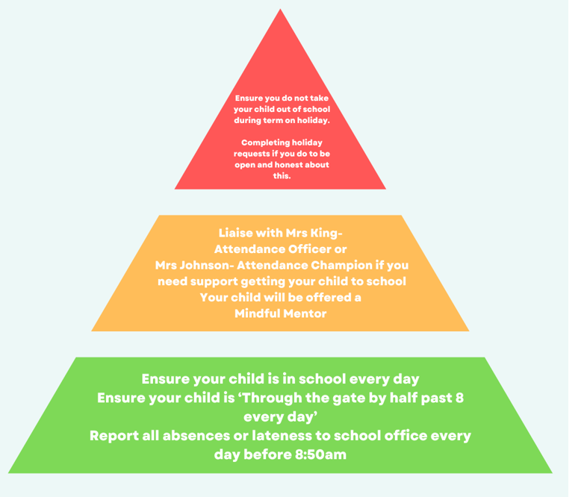
ATTENDANCE
PARENT GUIDE
Notes:
Holidays will not be approved unless it is extenuating circumstances (ruling based on DfE legislation)
School does not receive fine money
Attendance strategy will be uploaded onto website

Slide 22
BEHAVIOUR AND ANTI BULLYING
Notes:
Positive rewards – weekly headteacher’s award, star pupil, houspoints, recognition board, certificates, book vending machine
We have a no nonsense approach to bullying. Bullying is dealt with effectively and immediately by SLT. Sometimes children and parents can use the word bullied , when in fact it is a disagreement or fall out. Bullying is persistent behaviour towards another individual – online, face to face etc.
Behaviour at Woodside is good and we are proud of how our chn know our school rules and follow them- They know they need to be ready to learn , be respectful to all in order to keep everyone safe. Behaviour and Att- commented as being outstanding- Ofsted May 24
Restorative conversations

Slide 23

Communication
Notes:
Channels of communication have changed.
Office – new front of house Mrs Obery (afternoons pm)
No emails to staff on their email addresses – please send to office who will forward
Weekly newsletter/reminders
Behaviour/rewards (arbor) to follow this academic year

Slide 24

Communication
If we think your child needs extra support, we will always talk to you about this In the first instance, your child’s class teacher will liaise with you by arranging a meeting in school to discuss progress. There are scheduled progress meetings (parents evening) in the Autumn, Spring and Summer term which will provide an opportunity to discuss any concerns with their learning. | If you have any concerns, our door is always open. In the first instance, please speak to your child’s class teacher. Teachers are around at the start and end of the day for ‘a quick word’ but sometimes this may not be an appropriate moment for a discussion. Please contact the office to make an appointment to meet with the class teacher. If there are further concerns , please make an appointment with your child’s phase leader, then Mrs Bruntlett or Mrs Johnson.
Notes:
If you need to speak to a member of staff, please do so in the correct way.
Headteacher/deputy headteacher/Assistant headteacher’s doors are always open but sometimes if they don’t teach your child they won’t know about an incident that day that has happened in class.
It is better to contact the class teacher first and then if you are not happy, phase leader, then Mrs Bruntlett and then Mrs Johnson.

Slide 25
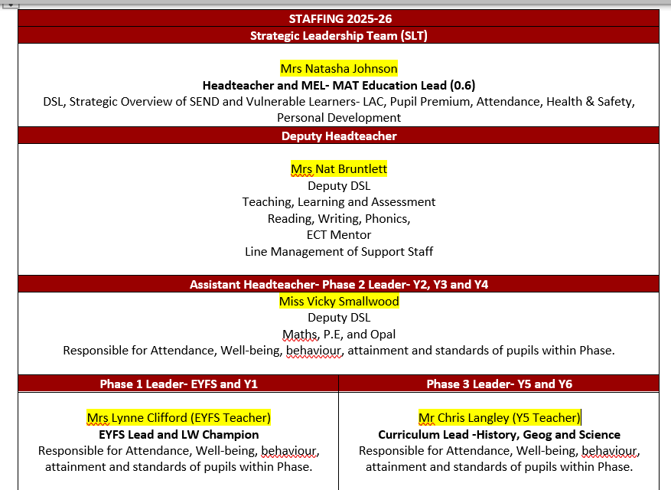
Notes:
If you need to speak to a member of staff, please do so in the correct way.
Headteacher/deputy headteacher/Assistant headteacher’s doors are always open but sometimes if they don’t teach your child they won’t know about an incident that day that has happened in class.
It is better to contact the class teacher first and then if you are not happy, phase leader, then Mrs Bruntlett and then Mrs Johnson.

Slide 26

SAFEGUARDING
Notes:
Keeping children safe is everyone’s responsibility – Please discuss with parents the importance of keeping their child safe at home. Checking devices- phones, XBOX etc
Mobile phone reminder – BDMAT no smartphones (National initiative being rolled out in all schools in the future). Staff will not deal with behaviour issues related to apps where parents have chosen to ignore the age ratings
School offers workshops led by Loudmouth, NSPCC, Connect for Health (Warwickshire School Nursing) to educate and promote positive behaviours

Slide 27




Next steps…
Notes:
Please keep talking- if you don’t tell us about issues we can’t fix them, we are an open book at Woodside and encourage partnership with parents. Work with us and if you have concerns come and speak to us rather than off load on social media platforms – as this doesn’t resolve the actual issue.
Be patient and remember as a school we don’t always get it right but we try our very best and are exceptionally proud of the journey we have been on and how much us as staff want the very best for all our chn , community and our wonderful village school.
Contact the school if have already looked at calendar, reminder sna dwebsite

Slide 28

EXTRA CATCH UP PROGRAMMES
Notes:
We offer catch up programmes-interventions in school. At the moment, we are currently baselining chn to see where they are on their return to school and what support if any individual children need.

