Slide 1

Reception
Parent Information Meeting
Woodside C of E Primary School
‘Together in God’s love we inspire and grow through living life in all its fullness’
Notes:
Aim
-to remind you about some of school’s aims and expectations that were spoken about in our first parents' information meeting back in the summer.
-to introduce you to aspects of school that you may not be sure about e.g. organisation of things.
-to let you know about some things that are coming up this half term in Reception.

Slide 2
OUR VISION and MOTTO
‘Together in God’s love we inspire and grow through living life in all its’ fullness’
John 10:10
OUR SCHOOL VALUES
OUR SCHOOL RULES
READY
RESPECTFUL
SAFE
HOPE
LOVE
FORGIVENESS
RESPECT
CHALLENGING INJUSTICE
Notes:
Vision-taken from the bible-Working together, in partnership – parents, children, BDMAT, community
Built around growth, inspiring and loving one another and living life in all its’ fullness- about happy , well-rounded children, who enjoy success and positive well-being.
Values-Big community, and as in life we need our children to be able to live in a big wide world where these values are just as important as well as being part of a faith school. Values are taught, modelled and lived out everyday-Challenging Injustice-Rec other day!
Rules-Really important and can be easily remembered by all children. Can be used in lots of situations- even at home!
We are proud that OFSTED recognised that behaviour at Woodside was Outstanding. They recognised our many positive rewards-weekly headteacher’s award, star pupil, housepoints, recognition board, certificates, book vending machine as well as observing restorative conversations where we teach the children to talk about any issues that arise with a T/TA.
We have a no-nonsense approach to bullying. It is dealt effectively and immediately by SLT. Sometimes children and parents can use the word bullied , when in fact it is a disagreement or fall out. We would like to remind you that bullying is persistent behaviour towards another individual.

Slide 3
Our School Improvement Priorities 25-26
What do we want to get better at this year?
1
Ensure all pupils ‘belong’ and thrive in every lesson through quality adaptive teaching.
2
Embed the quality of the depth, breadth, and coverage of the curriculum. (focus on Art, DT and R.E
3
Further embed the quality of teaching, learning and assessment to improve the combined % in R, W and M in all year groups.
4
Ensure maths teaching builds on previous learning to enable all pupils to make good or better progress
5
Implement a Nursery provision that allows pupils to flourish and succeed.
Notes:
JUST DISPLAY_DON’T READ
These are our SIP priorities for this academic year.
As a school this is what we will be working on and lots of staff training will be focused on developing these aspects. Might find Mrs J’s newsletters speak about aspects that are developing.

Slide 4

Uniform
Name everything inc shoes, water bottles, lunchboxes
Come to school in your PE kit on Thursday
No nail varnish or party tattoos
Ears that are pierced need to be removed for PE or they will will taped for safety
Long hair should be tied back.
Notes:
Please ensure children are wearing the correct uniform and that everything is named including shoes/water bottles and lunchboxes!
Come to school wearing PE kits on our PE day-Thursday
Children should not be wearing nail varnish to school and if they have party tattoos these should not be visible when at school.
If they have their ears pierced then they should be wearing stud earrings only and need to be taken out or covered up for PE
Long hair should be tied up not only for PE but also due to nit outbreaks!

Slide 5

What should my child bring to school everyday ?
Book bag
Water bottle
Coat
Please do not bring….
toys/ruck sacks/snacks

Slide 6

Communication
Open door policy
Speak to class teacher first before Phase Leaders and then Head and Deputy if needed
Email school office if you are unable to speak to teacher
Keep talking, if we do not know about things we can’t fix them
Notes:
Each week we have a weekly newsletter Fri/reminders-Sun. Sometimes you may get an additional email from us to remind you about something.
Any concerns-door is always open. Speak to us at start/end of the day-if we need longer then an appointment can be made by speaking to us directly or contacting the office either by emailing the school office or speaking to Mrs King or our new office member Mrs Obrey.
Phase leaders should be contacted first before asking to speak to SLT. I am also the Phase 1 leader for N/R and Year 1, however if you still have a concern, then an appointment can be made to speak to Mrs B DHT or Mrs J HT.
Headteacher/deputy headteacher/Assistant headteacher’s doors are always open but sometimes if they don’t teach your child they won’t know about an incident that day that has happened in class. It is better to contact the class teacher first and then if you are not happy, phase leader, then Mrs Bruntlett and then Mrs Johnson. May we also ask you to speak to members staff in the correct way. We do not tolerate parents speaking to any member of staff disrespectfully.
Please keep talking- if you don’t tell us about issues we can’t fix them, we are an open book at Woodside and encourage partnership with parents.
Work with us and if you have concerns come and speak to us rather than off load on social media platforms – as this doesn’t resolve the actual issue.
Be patient and remember as a school we don’t always get it right but we try our very best and are exceptionally proud of the journey we have been on and how much us as staff want the very best for all our chn , community and our wonderful village school.

Slide 7

What happens if my child is struggling with their learning and development at school?
We assess the whole child and pride ourselves in the early identification of children who may need additional support with their learning and development.
Notes:
Learning in EY is not just about trad subjects-as EY practitioners we look at the whole child because there are so many aspects of learning that are not traditional subjects that will build strong foundations for their future learning of more traditional subjects e.g. speech/ability to communicate and to get on with others.
As EY practitioners we are constantly interacting and assessing the children's development throughout the whole academic year but especially so in these first 6 weeks of starting school. It is vitally important that we identify and address if your child does not yet have those strong foundations that will support future learning.
We understand that all children develop at different rates however we are very proud and passionate about identifying those children who may need additional support with their development or learning as early as we can because we can them give them the best chance at education that we can. If we believe that your child will need additional support, we will contact you later in this half term or at any other point in the year to discuss what we have observed and how we can best support your child on their learning/development journey.
We have a robust SEND team which includes Mrs Johnson and is made up of Miss Orgill – SENCo and Mrs Day - SENCO Assistant and Pastoral Lead (pastoral = focus on supporting a child’s overall well being). Children are supported through learning plan targets which are set and reviewed termly. We also have access to our own SALT/Play Therapist/OT/EP which school pays for itself.

Slide 8

How can I find out about what my child is learning?
School website-EYFS section
Newsletter-every Friday
Homework opportunities
Emails from Reception
Weekly phonics information sheet
Parent workshops
Welly walks
Parent’s Evenings
Written report in July
Notes:
Lots of opportunities to find this out-school calendar that you received will be able to tell you specific dates of things.
Read and explain each one
Mention we are investigating online journals but ultimately do not want to be sending lots of messages through them as this takes us away from being with the children. HOLD FIRE!!
If you are concerned about their learning come and ask us!! We are a team around your child, and we want the best for them. Working together will do this.

Slide 9
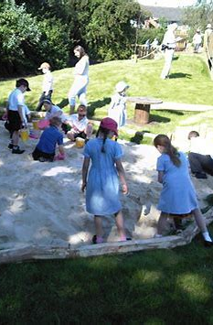
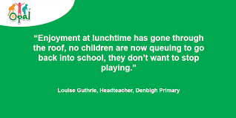
What happens to my child at lunchtime?
Bring coats everyday
Please put an additional drink in lunchboxes
Children are with Reception teachers until 12.30- then they go out to play with whole school
We will let you know if they have not eaten or struggling with lunch
Notes:
If have a packed lunch-please send an additional drink in the box.
Children have lunch in hall-we stay until 12.30 when we then have our lunch.
Children then get to play outside on the field/playground with the rest of school for Opal-All about play opportunities for all.
TAs /LSAs continue to oversee lunchtimes to improve lunchtime behaviour, relationships and provision. Since introducing, this has had positive improvements and a huge impact so far. SLT also on duty. Currently Reception wear hi-viz jackets so that they can be seen.
Coats should be brought in everyday.
We also endeavour to let you know if they haven’t eaten much
At moment they will be testing the menu and eventually you will get to know what your child is enjoying. Please do let you child know what they are having for lunch as this really helps.
Back up lunches!
If we notice your child is struggling with lunchtime in any way we will let you know.

Slide 10

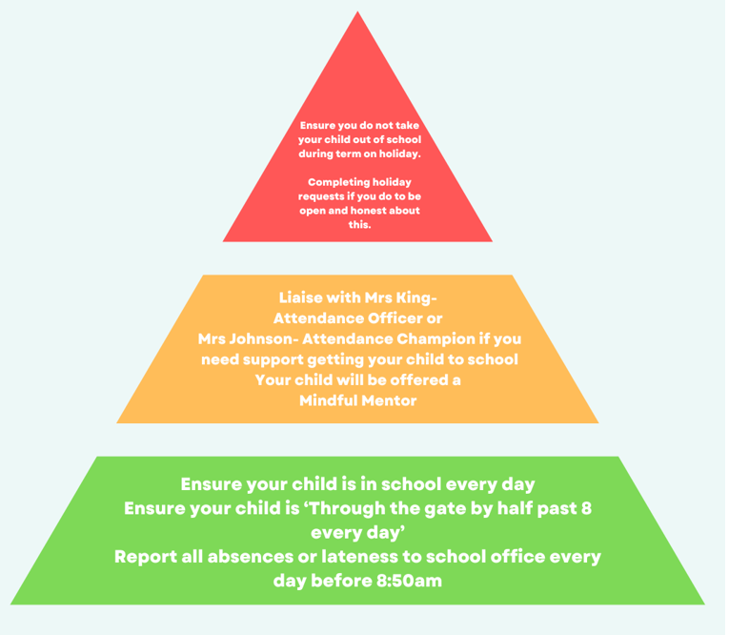
Should my child be in school everyday?
Yes-every school day counts, even in Reception!!
Notes:
Yes-every school day counts even in Reception!
Rec do get ill lots of bugs already going around but if they have a slight cough cold then they should be in-we will always call you if we feel they need to go home.
Holiday requests should be completed by collecting a form from the office.
Holidays will not be approved and unless it is extenuating circumstances (ruling based on DfE legislation)
Fines have been given but school does not receive fine money-WCC does

Slide 11

We can no longer give out cakes, sweets or chocolate for birthdays due to new EYFS statutory guidance around food.
What do I do if it my child’s birthday?
Notes:
We love to celebrate birthdays in Reception!
We will be sending out a class list of first names so that you can use this for any invites if your child is having a party-they will have a better social life!
You can also use this for Christmas cards.
Historically parents have sometimes sent in sweets/cakes or chocolates to celebrate birthdays however we are now unable to do this as part of new EYFS statutory guidance from the government. If you would like to provide any treats for the children we can now only help with this if it is a healthy snack-chopped fruit or another treat such as little itmes that you may put in a party bag. If sweets do come in we cannot give these out so will be put back in bags.

Slide 12
What is happening this half term in Reception?
Reception Baseline Assessment
WELLCOMM screening assessment
Physical development assessment
Phonics workshop
Number workshop
Reception family welcome service at St Nicholas’s Church
Individual photos
Notes:
Read and explain each one

Slide 13
Thank you for coming!
Notes:
Any q’s please ask.

