Slide 1
Times tables
Woodside C of E Primary School
‘Together in God’s love we inspire and grow through living life in all its fullness’

Slide 2
Counting and looking for patterns.
Example: Counting in 2s
2, 4, 6, 8, 10…
Ensure children have a strong understanding of counting in groups first.
When children are secure with counting, they can then look for patterns.
Notes:
Counting will start before beginning to develop understanding and reasoning but will continue long after, until all times tables can be counted through sequentially at speed.
Counting using manipulatives should start with physical objects (shoes, socks, hands etc) before moving on to counters etc
Whenever starting children counting in a new amount, such as counting in 8s, children should be given the opportunity to see visually what that looks like to reinforce 4 x 8 looks quite big compared to 4 x 6.
Patterns could be 4 x 8 is the same as 4 x 4 doubled.

Slide 3
Repeated addition
Knowing that 2 x 4 is the same as 2 + 2 + 2 + 2
2 + 2 + 2 + 2 = ?
2 x 4 = ?
Notes:
Children need experience of using concrete manipulatives such as counters or multilink cubes and pictorial representations of objects, forming arrays.

Slide 4
Multiplication is commutative
3 x 2 is the same as 2 x 3
Children need to understand that multiplication can be completed in any order to produce the same answer. Sometimes this link needs to be made explicit.
3 lots of 2 = 6
2 lots of 3 = 6
Notes:
Children build on their existing understanding using arrays, turning the arrays around to show that you now have 2 groups of 3 and they will still total 6. This can then be linked to recalling multiplication facts, e.g. if they know their 2 times table as facts but not their 3 times table, they can use 2 x 3 to work out 3 x 2.

Slide 5
Multiplication is the inverse of division
20 ÷ 5 = 4 can be worked out because 5 x 4 = 20
Using pictorial representations (such as arrays) is useful here for children to see the link between multiplication and division.
Notes:
Even though division is not tested in the MTC, it is important that pupils have a strong understanding of the connection between multiplication and division.
Again, the use of arrays is key. Children need experience of pulling arrays apart into groups or sharing. After basic experience has been gained, the children should start to ‘see’ an array structure as 5 groups of 4 equal 20 and 20 can be split into 5 groups of 4.

Slide 6
Fact families
4 x 5 = 20, 5 x 4 = 20, 20 ÷ 5 = 4, 20 ÷ 4 = 5
Due to their commutative understanding, children should also be able to see whole number families. For many children this will need to be pointed out and discussed.
20
4
5
Notes:
From here it is only a short jump to understanding that any missing number can be worked out through knowledge of number families, e.g. 4 x [ ] = 20 or [ ] ÷ 4 = 5. There are other methods children can use to work out missing numbers but our goal is to increase working memory in order to increase instant recall from long term memory. Being able to bounce around a number family will achieve that.

Slide 7
Using known facts
4 x 6 = ?
I know 4 x 5 = 20
Therefore, 20 + 4 = 24
By using known facts from ‘easier’ times tables, children should be able to find answers with increasing speed.
+

Slide 8
Related facts
8 $×$ 3 ones $=$ 24 ones
8 $×$ 3 $=$ 24
3 $×$ 8 ones $=$ 24 ones
3 $×$ 8 $=$ 24
8 $×$ 3 tens $=$ 24 tens
8 $×$ 30 $=$ 240
3 $×$ 8 tens $=$ 24 tens
3 $×$ 80 $=$ 240

Slide 9
There are 2,114 seats in a theatre. The theatre is fully
booked for 3 shows. How many people attend overall?
2,114 $×$ 3
Thousands | Hundreds | Tens | Ones
 | 2 | 1 | 1 | 4
$×$ |  |  |  | 3
6
3
4
2
1
Do you need to make an exchange?
Have a think
6,342 people attend.

Slide 10
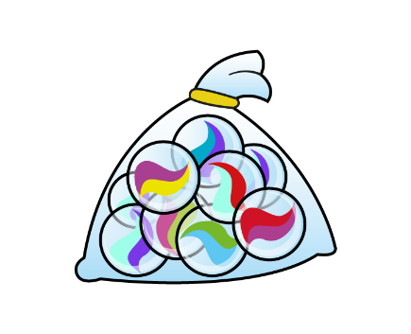

Slide 12
Specific arrangements for the check
Some children will be eligible for specific arrangements:
Colour contrast;
Font size adjustment;
‘Next’ button (alternative to 3-second pause);
Removing on-screen number pad;
An adult to input answers;
Audio version;
Audible time alert.
Notes:
Children eligible for access arrangements are:
Children with an EHC plan
Children who have provisions made in school using the SEND support system.
Children with behavioural, emotional or social difficulties
Children with EAL
Schools do not need to request permission to use access arrangements. The support should be based on the support provided in school and should not advantage or disadvantage individual children.
A child can be assigned more than one access arrangement, if required.

Slide 13
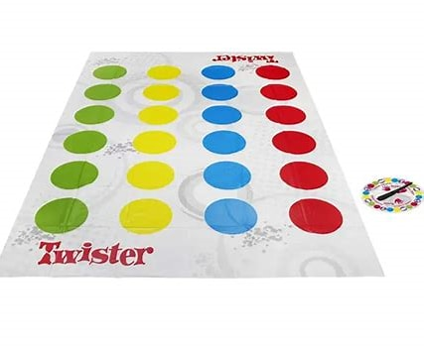
Contenders practice until they get it right… Champions practice until they can’t get it wrong!
Times Table Rockstars Times Tables Rock Stars (ttrockstars.com)
Topmarks hit the button
Percy Parker (Youtube)
Timestables.co.uk Times tables games - Learn them all here!
Playing cards, dice, flash cards and physical challenges!
Times tables collection - BBC Teach – supermovers!!
Best times table apps

Slide 14
Multiplication Check
End of Year 4
Practice link:
Multiplication Tables Check - 2025 - Timestables.co.uk

