Slide 1
Year One
Phonics Screening Check
A Guide for Parents

Slide 2
Chapters
1
What is Phonics?
2
What is the Phonics Screening Check?
3
What Happens During the Screening?
4
Pseudo Words (Nonsense words)
5
Reporting to Parents
6
How Are the Results Used?
7
How Can I Help My Child at Home?
next page

Slide 3
What is Phonics?
Children begin to learn phonics (sounds) in early years, both nursery and reception. Once children begin learning sounds, these sounds are used orally to identify and make words. They will then begin to learn the letters which make each of the sounds and these are used to read and spell words.
Once children begin learning sounds, these sounds are used orally to identify and make words. They will then begin to learn the letters which make each of the sounds and these are used to read and spell words.
chapter
menu
next page

Slide 4
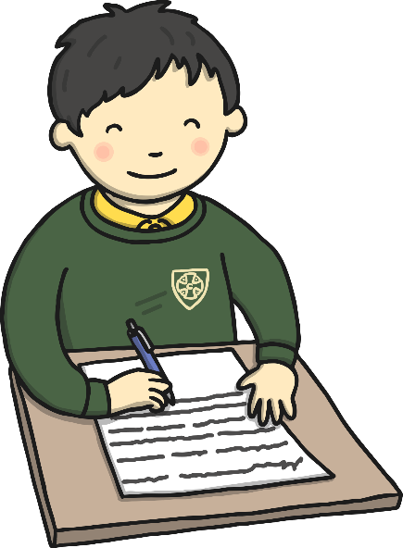
What is the Phonics Screening Check?
Children in Year 1 throughout the country will all be taking part in a phonics screening check during the same week in June. Children in Year 2 will also take the check if they did not achieve the required result when in Year 1 or they have not taken the test before.
Headteachers should decide whether it is appropriate for each of their pupils to take the phonics screening check. The phonics screening check is designed to confirm whether individual children have learnt phonic decoding and blending skills to an appropriate standard.
chapter
menu
next page

Slide 5
What Happens During the Test?
The test contains 40 words. Each child will sit one-to-one and read each word aloud to a teacher. The test will take approximately 10 minutes per child, although all children are different and will complete the check at their own pace. The list of words the children read is a combination of 20 real words and 20 pseudo words (nonsense words).
chapter
menu
next page

Slide 6
Pseudo Words (Nonsense Words)
The pseudo words will be shown to your child with a picture of an alien. This provides the children with a context for the pseudo word which is independent from any existing vocabulary they may have. Pseudo words are included because they will be new to all pupils; they do not favour children with a good vocabulary knowledge or visual memory of words.
chapter
menu
next page

Slide 7
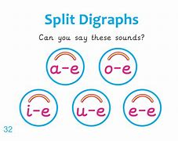
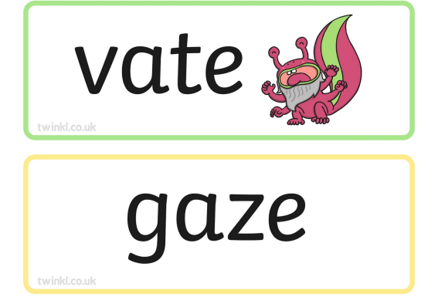
Diagraphs- 2 letters making one sound.

Slide 8
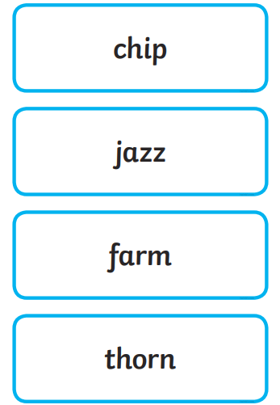
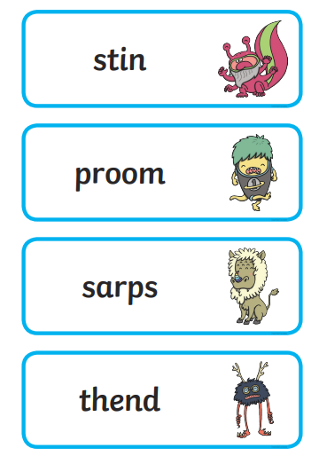

Slide 9
‘Put your split diagraph phonics goggles on’.

Slide 10
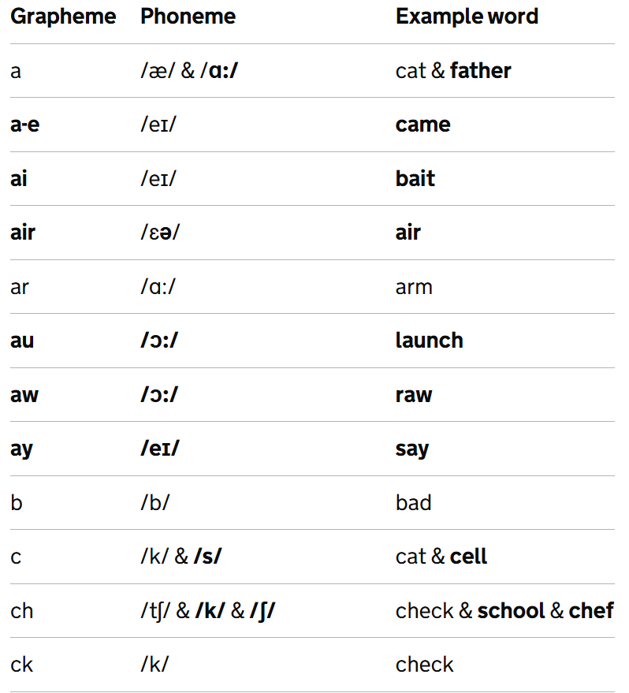

Slide 11
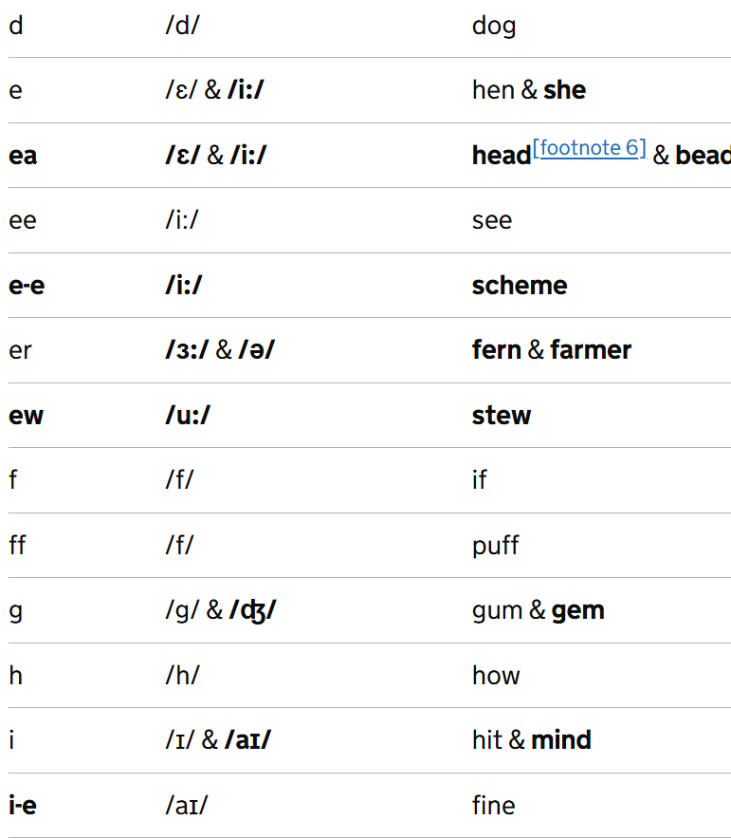

Slide 12
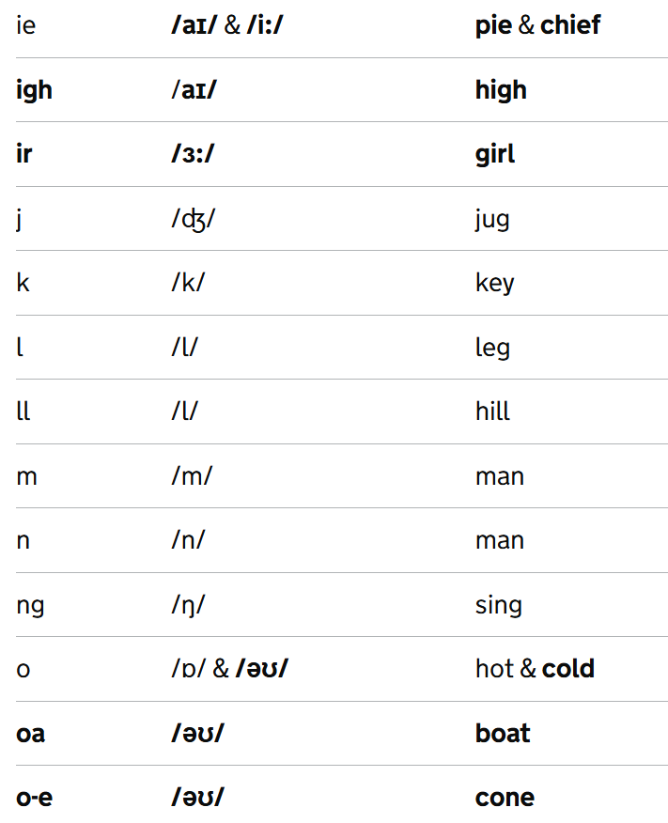

Slide 13
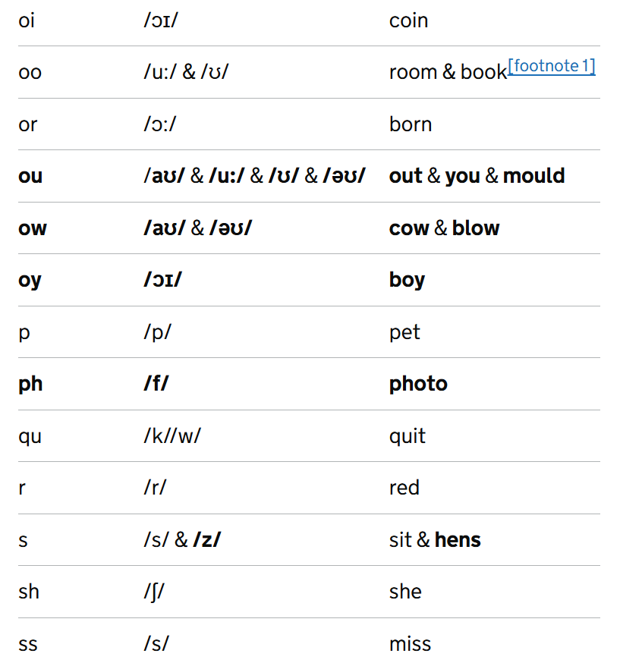

Slide 14
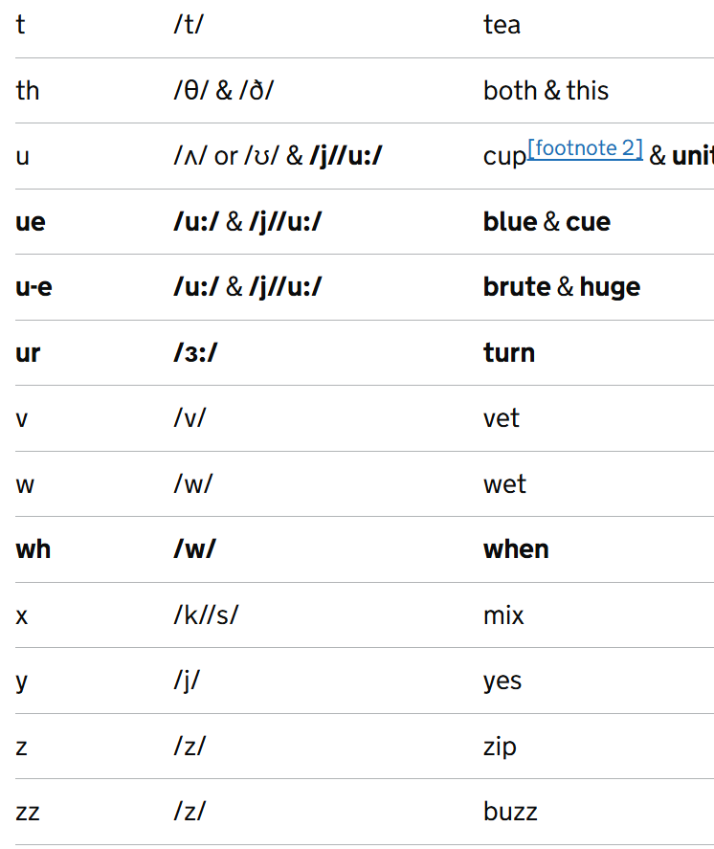

Slide 15
Reporting to Parents
By the end of the summer term all schools must report each child's results to their parents. They will also confirm if the child has met the standard threshold. Children who do not achieve the expected level will retake the test when they are in Year 2.
chapter
menu
next page

Slide 16
How Are the Results Used?
Results from the check will be used by schools to analyse their own performance and for Ofsted to use in inspections.
chapter
menu
next page

Slide 17
How Can I Help My Child at Home?
Play lots of sound and listening games with your child.
Read as much as possible to and with your child.
Encourage and praise – get them to have a ‘good guess’.
If your child is struggling to decode a word, help them by encouraging them to say each sound in the word from left to right.
Blend the sounds by pointing to each one, e.g. /c/ in cat, /p/ in pat, /ng/ in sing, /ee/ in been. Next move your finger under the whole word as you say it.
Discuss the meaning of words if your child does not know what they have read.
chapter
menu
next page

Slide 18
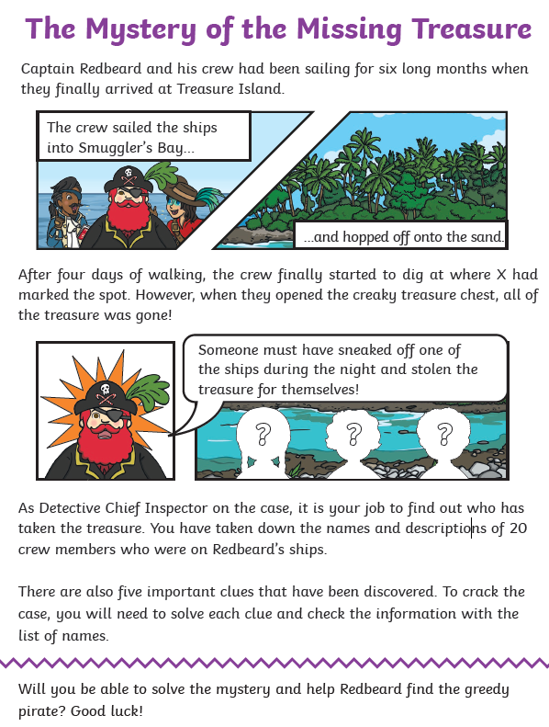
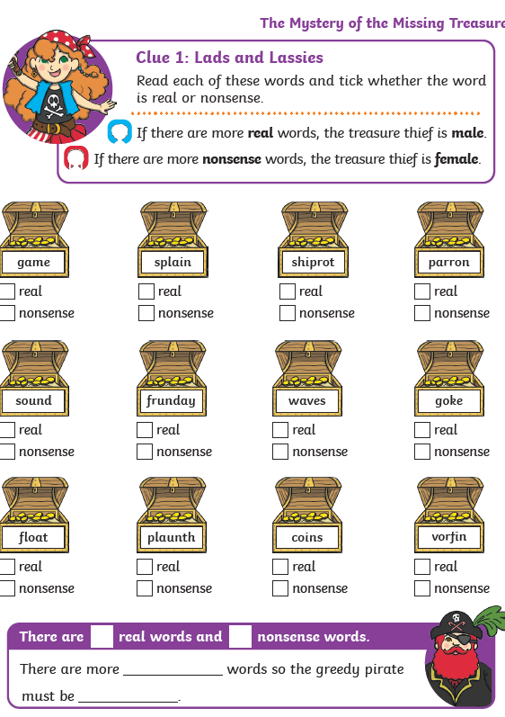
Half Term Homework 10 team point challenge! Ask for paper copy☺

Slide 19
Online Phonics Screening Check Tool - Monster Phonics
Some helpful websites…
Picnic on Pluto
Revision Materials - Phonics Screening Check - Twinkl
Ask Miss Groucott to print some flashcards.
Avoid using practise test papers as we will use these at school to identify gaps and see which sounds the children need re-teaching. If they have already seen the words they will just guess and not decode properly.

Slide 20
Thank you ☺ Questions?

