Slide 1
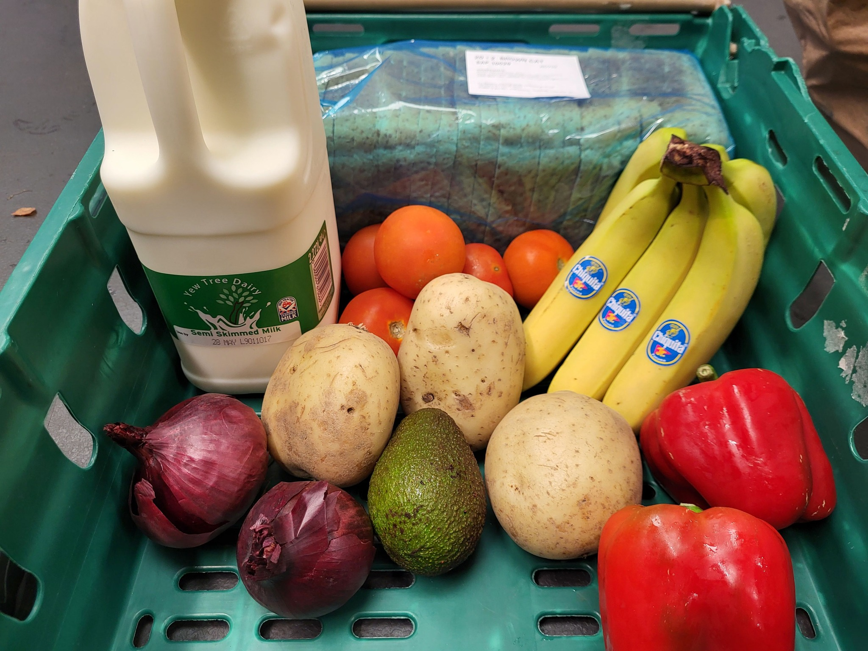
North Warwickshire Food Banks
We Care Uk . North Warwickshire Borough council.
One off Emergency foodbank parcel delivery.
https://form.jotform.com/240841829323356
Atherstone
Facebook – Edible Links – Holiday bags available requesting donation, including gluten free, milk alternatives, cleaning bags
Https://www.facebook.com/Ediblelinks17/?locale=en_GB
White Heart Group Atherstone White Heart House, Long Street AtherstoneTuesday - Friday 10am -2pmHot drinks and biscuits or soup and bread - all welcome
White Hart Community FridgeWhite Heart House, Long Street AtherstoneTuesday and Thursday 10am-1pm Weds 7-9pm01827 946458
Atherstone childrens Centre - for families registered at the centre store cupboard bag donations
North Warwickshire borough council food bank - https://www.northwarks.gov.uk/info/20016/council_housing_and_garages/1297/help_with_money_and_debt
(Donation £2 for above edible links pantry)

Slide 2
Apps and websites
Too Good To Go App - The app that lets customers rescue unsold food from shops and restaurants to save it from going to waste.
Warwickshire Local Welfare Scheme
Love Food Hate Waste - safe food storage and making use of your leftovers - https://www.lovefoodhatewaste.com/
NHS Change4Life - food facts NHS - eat well guide https://www.nhs.uk/healthier-families/
Educaterers have produced their first recipe book for inspiring ideas on cooking meals with children - https://educaterers.co.uk/downloads/educaterers-recipe-book.pdf
BBC good food Budget dinner recipes: https://www.bbcgoodfood.com/recipes/collection/cheap-eat-recipes

Slide 3
Feeding Your Family in Warwickshire
Please click on the links for further information
Feeding your family – Warwickshire County Council
Langar Aid

Slide 4

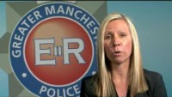
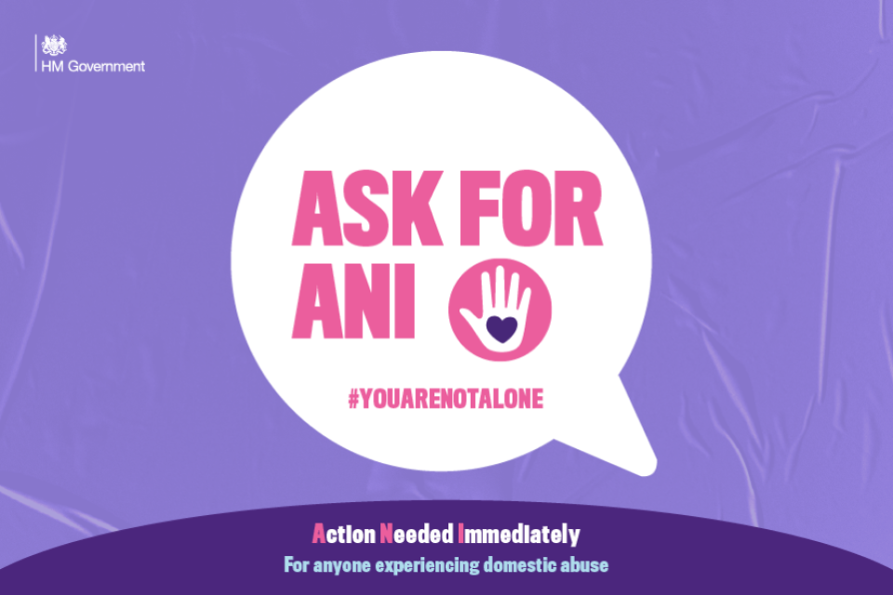
Signposting and support services for parents and families
National centre for Domestic violence Domestic Violence & Abuse · Emergency Injunction Service (ncdv.org.uk)
Refuge Refuge, the largest UK domestic abuse organisation for women
Domestic Abuse Counselling Service DACS – Domestic Abuse Counselling Service (dacservice.org.uk)
Family Intervention Counselling Service Family Intervention Counselling Service (FICS) (interventionservice.co.uk)
Claires Law Request information under Clare's Law: Make a Domestic Violence Disclosure Scheme (DVDS) application | Warwickshire Police
Women’s Aid Home - Women's Aid (womensaid.org.uk)
Mankind- Tel: 01823334244 email: admin@mankind.org.uk
Ask for ANI codeword if you are experiencing domestic abuse and need immediate help, ask for ‘ANI’ in a participating pharmacy. ‘ANI’ stands for Action Needed Immediately. If a pharmacy has the ‘Ask for ANI’ logo on display, it means they’re ready to help. They will offer you a private space, provide a phone and ask if you need support from the police or other domestic abuse support services. Ask for ANI logo used in participating pharmacies
Victim support https://www.victimsupport.org.uk/
Notes:
NCDV-national centre for domestic violence, A free, fast emergency injunction service to survivors of domestic violence regardless of their financial circumstances, race, gender or sexual orientation
Refuge will support at any age.
FICS-We are a specialist therapeutic agency based in Warwickshire. We work with families and individuals who have experienced domestic abuse.
Women’s aid have a live chat function, survivors forum, a survivors handbook, information and advice on how can I support and help my children, resources such as leaflets and toolkits for supporting healthy relationships, expect respect, control in relationships.
Mankind - Mankind provides a confidential helpline for male victims of domestic abuse and domestic violence along with information and advice for victims and professionals and survivors’ stories.
Victim support-

